Slide 1
Blended Learning Award
Information Session
Norma Nocente, Associate Director CTL

Slide 2
Purpose
Support instructors in the redevelopment of their course
Increase student engagement
Improve student experience

Slide 3
Blended Learning
Garrison & Vaughan
…the thoughtful fusion of face-to-face and online learning experiences. That basic principle is that face-to-face oral communication and online written communication are optimally integrated such that the strengths of each are blended into a unique learning experience congruent with the context and intended educational purpose. (Garrison & Vaughan, 2008, p. 5).
Notes:
In their 2008 book, Blended Learning in Higher Education: Framework, Principles, and Guidelines, Randy Garrison and Norm Vaughan define blended learning as

Slide 4
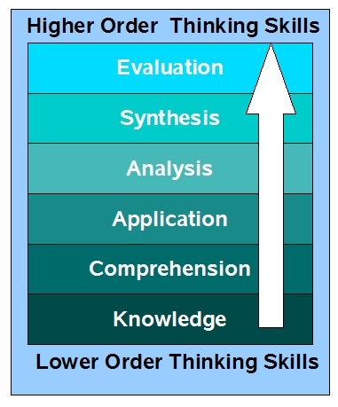
Traditional Classroom
Generally done out of class (labs, seminars, projects and assignments)
Generally done in class (lectures - and sometimes before if readings are done)

Slide 5
Blended Learning
Generally done in class, with additional projects and assignments after class
Generally done out of class by placing lecture content online – ideally leading to a reduction in physical class time

Slide 6
Blended Learning Examples
Visit http://blendedualberta.ca/ for case studies

Slide 7
Levels of Funding
Level 1 -partial redevelopment of about 25%-30% of the course. The maximum amount awarded for Level 1 will be $15,000.
Level 2- redevelopment of at least two-thirds of the course. The maximum amount awarded for Level 2 will be $50,000.

Slide 8
Criteria
the merit of the proposal for impacting learning and student experience;
the potential for transformation or scalability at the department, faculty or institution
The likelihood of success; and
within the capacity of CTL to resource.

Slide 9
Impact on Learning and Student Experience
Application of concepts
Problem solving
Discussions
Reflecting on process
Critiquing and evaluation
Case studies

Slide 10
Potential for Transformation or Scalability
High throughput courses
Core courses in a program
Shift teaching approach in a department or unit

Slide 11
Likelihood of Success
Ideas are worthwhile changes
Ideas presented seem feasible
Instructor has the capacity to redevelop the course

Slide 12
Within CTL’s Capacity
What can CTL do?
Instructional design
Multimedia development (video production, animations, audio, graphics)
Upload course materials on eClass
What can’t CTL do?
Computer programming to develop an application
Set up classroom technology infrastructure

Slide 13
Expression of Interest Application
Briefly describe the course. (50-100 words)
What are your reasons for converting this course to a blended format? (200-300 words)
What is the issue? How will a blended format help?

Slide 14
Expression of Interest Application
What are your ideas for changing this course? (200-300 words)
Will this be a flipped class with reduced F2F time?
Describe student activities in a typical week
How will you increase student engagement in the F2F portion of your course? (200-300 words)
Be specific about the activities you envision for the the face-to- face class.
How is this different than what you currently do?

Slide 15
Two-Step Process
Expressions of Interest due January 18 (5:00 p.m.)
All expressions of interest will be evaluated by the Provost Digital Learning Committee. Notification of results on February 8th.
Selected proposals invited to submit a full proposal
Full proposal due March 8 (5:00 p.m.)
Norma Nocente will work with the instructor /instructor team to identify the scope of the project and to develop a budget.
Notification of results on March 29.

Slide 16
Questions

Slide 17
Contact
Dr. Norma Nocente
Associate Director (Educational Technology)
Centre for Teaching and Learning
norma.nocente@ualberta.ca
780-492-3676

