Slide 1
State of the Residency Program 2012
Dr. Brent MacNicol, Residency Program Director
UofA Anesthesiology
September 7, 2012

Slide 2
Objectives
Review the past year’s challenges and successes
Learn about some upcoming changes

Slide 3
The past year

Slide 4
The year in review
July – Welcome BBQ
August – AKT 24 exam
September – ICRE, Simulation program starts, ½ day starts
October – LMCC – II exam (PGY2), AKT 6 exam, ACRM
November – Practice oral exam (all residents)
December – ½ day written exam (all residents)
January – Resident wellbeing retreat
February – CaRMS interviews, “Making the Mark”
March – CaRMS results, ABA practice exam
April – RC written exam, practice oral exams
May – Research Day
June – RC oral exams, ½ day written exam, CAS, Portfolio workshop

Slide 5
Associate Program Director
Dr. Jason Taam

Slide 6
Research Director
Dr. Ferrante Gragasin

Slide 7
Exam Success!
All PGY5 residents pass RCPSC exams!
Both FP-A residents complete!
Notes:
6 PGY-5 residents all passed their exams – reflecting on the clinical experience and clinical teachers that we have

Slide 8
Research Day
Gelfan & Bell Research & Education Symposium
Notes:
Highest attendance every (76)
New format – resident, fellow, pharmacology research, invited speakers, workshops (ultrasound guided regional and airway)
Held during day rather than evening

Slide 9
Resident Research at CAS
Dr. Angela Neufeld
Our own Research Day winner
Oral Presentation
“Electrical Guidance of Tracheal Needle Placement in Human Cadavers”
Notes:
Our own research day winner, with the best 100% resident research project
Unfortunately couldn’t compete with the more experienced presenters

Slide 10
Mentoring
The planned meeting of the mentors and CPD event did not end up happening
The residents (for the most part) report that they are using their mentors and that this is a valuable component of their training.

Slide 11
Now & the future

Slide 12
New Residents!
CaRMS
Jalal, Simon Rose, Geoff Brin, Justin Byers
Transfer
Andrea Kreitz, Jeff Campbell
Re-entry
Neethling van den Heever
IMG
Ashley Fyfe-Brown

Slide 13
Summer Lecture Series
Arranged by Angela Neufeld and Craig Needham
Topics were chosen to cover more recent developments in anesthesiology than ½ day which covers basic knowledge instead
Notes:
Full year academic days follow what most other programs in Canada currently do
Loss of ‘rest & relaxation’? Loss of clinical exposure?
Large success from resident point of view, but final survey not yet known

Slide 14
Portfolios
Reflective journals in which residents record their experiences for enhanced learning and future reference
Highly effective workshop
Notes:
Dr. Kearney and I held a portfolio workshop which the residents enjoyed. The most common feedback I have received from the portfolios, and the workshop specifically, is along the lines of “I was surprised to learn that my colleagues had gone through similar or identical experiences’ ‘It was valuable getting feedback and ideas from other residents’

Slide 15
Challenges
Simulation
Competency-
based
training
Ultrasound /Echo
Decreased training
time?
Demands on staff time
Expanded Sites
Assessment
Strategies
16-hour call?
Expanded roles
Notes:
New seminar format modalities, looking into podcasts (reduced staff preparation and time needs)
Staff benefits for participating (exposure to and practice in the simulator – before RC or CPSA makes it mandatory)
Arrange for staff CPD that parallels how the residents will need to be taught (eg simulation facilitation)
This job of PD is no longer just making sure that the residents do what they are supposed to. It is now becoming about how to mold a program

Slide 16
Evaluation

Slide 17
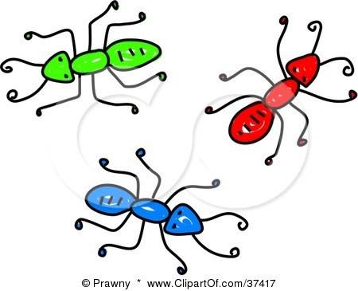
A.N.T.S.
Anesthesia
Non –
Technical
Skills
Notes:
Refers to the other CanMEDS roles that are so difficult to assign scores to on daily evaluations.
Cognitive skills such as problem-solving, communication, collaboration, health advocate, manager, scholar and professional

Slide 18
360º Evaluations
360 format and questions based on the CPSA “Physician Achievement Review”
Notes:
Which I’m sure you are all familiar with. Surgery foundations (PGY1-2) has already been using this quite sucessfully

Slide 19
Residency Program Committee
Program Director & Assoc. Program Director
Site Coordinators – UAH, RAH, GNH, MIS
Rotation Coordinators – Peds, CV, Regional, Chr. Pain, Airway
General (UAH, RAH, GNH, MIS), Neuroanesthesia
Obstetrical, Thoracic, FPA, Research
GNH – Senior (combined vascular and obstetrical)
Chief Resident
Resident Rep from each year (5)

Slide 20
Objectives
Review the past year’s challenges and successes
Learn about some upcoming changes

Slide 21
I am not always around, but someone is
If you want to get involved or have a suggestion
email or call
brent.macnicol@ualberta.ca
780-953-11263
Jason Taam
Marilyn or Darci (780-407-1877)
Any other committee member

