Slide 1
The Challenges of Multi-Sponsor Partnership Projects
RAD 202
Nancy Klimczak – Assistant Director, Partnership and Institutional Projects
Amanda Rosnau – Manager, Partnership Projects

Slide 2
Today’s Aim
Explain some of the particular challenges inherent in multi-sponsor projects
Understand what each of us can do to help make the negotiation and financial administration of these projects happen faster and more smoothly
Discuss some of these issues in the context of Tri-Agency funding (NSERC)

Slide 3
Who Are We, and What Do We Do?
The Partnerships Team handles projects where funding is coming from more than one source, necessitating either:
Review and negotiation of several agreements that affect each other in a legal manner, or
Integral financial management of the project, for example cross-reporting (between RES’s) to more than one sponsor
We also negotiate and process “Relationship Agreements”, for example MOU’s with other institutions and/or sponsors.

Slide 4
The Basics: Project Lifecycle
Basic steps for new project:
Application
Decision
Complete Documentation
Negotiation of Agreement(s)
Award Processing and Set Up
Financial Administration
Subgrants
Amendments
You can find detailed lifecycle information here: http://www.rso.ualberta.ca/Lifecycle.aspx

Slide 5
What Difference Does the Number of Funders Make?
Increased time to negotiate and set up accounts
Multiple partners = multiple opinions (and lawyers!)
Competing priorities: UA, government, and sponsors
Must harmonize multiple agreements or meet matching program requirements
Amendments go through more parties
Subgrants tied to all funding conditions
International parties = legal consultation

Slide 6
What Difference Does the Number of Funders Make? cont’d
Increased complexity in financial administration
Matching programs (ex: NSERC CRD) = harmonizing reporting over multiple accounts
Consolidated reporting
Impact of subgrants

Slide 7
Negotiation Time Savers
General things the researcher’s team can do to help:
Submit requests to RSO as early as possible
Obtain required internal and external signatures or approvals
Turn your mind to ethics certification early
Respond to Agreements Administrator (AA) requests for information
Assist with Sponsor follow ups
Advise us if the PI or a key contact will be away for an extended period of time

Slide 8
Negotiation Time Savers cont’d
General things that RSO/ Partnership team does to help:
Invests in training for staff
Triages files appropriately
Keeps in regular contact with PI/Sponsor
Uses templates where appropriate
Avoids drafting wars
Controls the process (aka “cat herding”)
Seeks early consultation with Legal, TEC Edmonton, Risk Management & SMS

Slide 9
Negotiation Delays
Unusual IP arrangements
Confidentiality concerns
Publication – no secret research!
Warranty and indemnity changes
Sponsor education (on match programs, UA policies)
Poor fit b/t project scope and funding vehicle
Moving targets – budgets (incl ICR) and scope
Non-responsive parties

Slide 10
Negotiation Delays cont’d
Intellectual Property (IP)
This can be complicated even when negotiating a single-sponsor agreement:
Must respect UA policies for student IP (thesis ownership)
Must, at minimum, allow PI ability to use IP for non-commercial research and teaching purposes
Must accommodate appropriate use by all sponsors
May involve significant consultation with TEC Ed and Legal

Slide 11
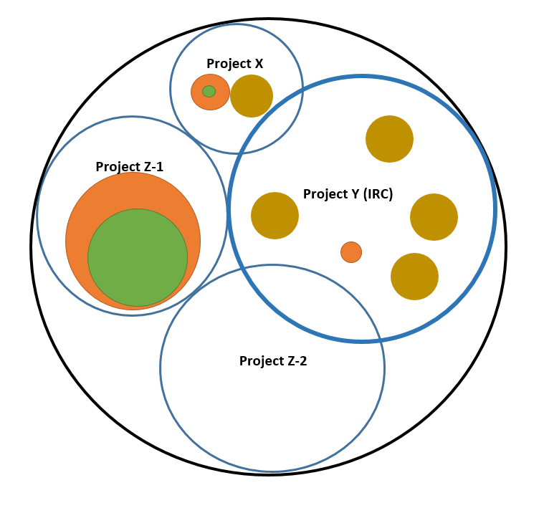
Intellectual Property – PI’s Career-long Research Portfolio
Legend:
Research Results
Patentable IP
Patented IP
Student Thesis

Slide 12
Negotiation Delays cont’d
Confidentiality and Publication
Companies are often concerned about who sees what information, how it will be used and what will make it into a publication
PI can help by:
Creating a tight scope
Telling sponsors how they will manage this on day-to-day basis
Warranties/ Indemnities
Clauses are inherently complex
Not much PI can do to help, besides general sponsor relationship building – just be aware that if several parties start parsing the language, it will add some time

Slide 13
Negotiation Delays cont’d
Sponsor education/poor fit
RSO provides relevant info to sponsors to pave the way:
links to programs
annotated agreements
copies of policies
PI should ensure a project is suitable for the funding model chosen:
Should it even be an NSERC CRD or IRC?
Will these sponsors work well together?
Does one of the sponsors need a service agreement on the side?

Slide 14
Negotiation Delays cont’d
Stuck in the Middle With You! (No action item for AA)
Have scope and budget finalized before reaching the negotiation stage
Turn mind to ICR issues early
Assist with non-responsive parties

Slide 15
Tips for Amendments
Remember that amendments will require permission/ signatures from all parties
Submit request early – the more parties, the longer it will take to get sign off, even on a simple amendment
Consider including joinders from the very beginning

Slide 16
Tips for Subgrants
These can be tricky on partnership files:
May be multiple agreements to draw from in setting up obligations
May be multiple accounts involved
Often heavily customized
NSERC CRDs
Need to consider parallel spending requirement
International collaborators
May be unfamiliar with Canadian agency granting rules
Typically require legal input

Slide 17
Financial Administration
NSERC CRDs : 20% Budget Category Variance Rule*
Cannot vary the budget categories by more than 20% without seeking permission IN ADVANCE from NSERC
Rule applies to matching industry funds as well
NSERC can disallow expenses beyond this threshold
Must communicate this to any Co-PIs
Therefore:
Build in specific line items appropriately
Check in early with the program officer if you suspect this may be an issue

Slide 18
Financial Administration cont’d
NSERC CRDs : Parallel Spending Rate (50/50 spending)
NSERC expects PIs to spend industry funds at the same rate as the NSERC funds.
NSERC knows that industry funds often lapse to PI’s general research account
NSERC can require PIs to transfer expenses between the various accounts for the project
RSO specifically notes this in the terms (visible to PI!) during set up in Grants 3 (PeopleSoft)
Note: same principle applies for other match-style funders

Slide 19
Financial Administration cont’d
NSERC CRDs / IRC’s – Payment from sponsors
NSERC is matching the cash from your industry sponsors
NSERC requires the RSO to confirm receipt of payment
At times we have difficulties collecting payment from industry sponsors
PI’s have a 1:1 relationship with the sponsor and often can connect at a different level to assist the RSO in requesting payments
Keep RSO informed if your contacts at your sponsor change
NSERC must be kept informed in a timely manner if sponsors do not pay or drop out of the project

Slide 20
Financial Administration cont’d
Interim Financial Reporting
If it is an interim report is due and the sponsor accepts flash reports, this is provided by the PI. RSO only provides the official signed reports to the sponsor
Claim Based Reporting (ex: WED, NRCAN, Clusters)
(these require heavy involvement from the PI)
The PI is responsible for the actual claim and backup documentation
The PI completes the non assisted costs details when required
RSO reviews the claims and backup documentation and submits to the sponsor
Expenditures for the period must be incurred during the period

Slide 21
Financial Administration cont’d
Subgrants
Conditions for payment:
Annually UA must have received payment from the sponsor to issue payment to your subgrantee
You are required to manage your budgets/funds available in order for RSO to pay your subgrantees!
Reporting
RSO collects and consolidates financial reporting from all subgrantees on the project
UA PI’s will need to review and sign off on the consolidated financial report

Slide 22
QUESTIONS?
Feel free to contact us any time!

Slide 23
Online Evaluation Form
We appreciate your help in evaluating this presentation!
The RAD evaluation form is accessible online. Click here or click on the blue checkmark below (right-click the hyperlink(s) and click Open Hyperlink to activate).

