Slide 1
Introduction to Ualberta’s New Purchasing Platform RESEARCH ADMINISTRATION DAY 2016 June 1 2016
Notes:
Welcome Introductions

Slide 2
Presentation Points
Introducing SupplyNet
Project Objectives
Supplier Connection
How does SupplyNet work
Demo
Inquiry
Opportunities
Schedule
Website, Communications & Training
Questions?
Notes:
Today’s presentation will introduce you to SupplyNet, update you on the project schedule & rollout as well as provide a Demo of the system.
We have time scheduled for questions at the end.

Slide 3
Introducing SupplyNet
Introducing. . . .
The University of Alberta’s new eProcurement system
Coupa software platform
Connecting Suppliers to the U of A campus community
An end to end, procure to payment solution
One solution to replace multiple Ordering Processes (PeopleSoft Requisitions, LDP process etc.)
Notes:
SupplyNet is an end to end procure to payment solution which is intuitive and user friendly.

Slide 4
Introducing SupplyNet
=
Rated as the most intuitive and user friendly Product
Highest ranked Procure to Pay Solution (Gartner 2015)
Other Clients:
Massachusetts Institute of Technology – MIT (Procurement and Expenses)
Major Canadian Banks

Slide 5
Objectives
Implement an efficient, easy-to-use eProcurement solution
Position the University to significantly reduce manual purchasing and payables activities
Reduce the number of available purchasing processes. Bring what is currently “distributed purchasing activity” into an eProcurement platform
Improve spend visibility, management and controls. All purchasing activity in one solution
Notes:
Project objectives were to implement an efficient easy to use eProcurement solution, reduce manual purchasing and payables activities while reducing the number of available purchasing processes and improving spend visibility, management and controls.

Slide 6
Supplier Connection
Connects with Suppliers in three different ways:
“Punchout” or CxML (Commerce Extensive Markup Language)
CSN (Coupa Supplier Network)
Email
Requisition is created in two ways:
“Punchout” to Supplier Catalogue
*Access to UA’s Preferred Supplier pricing
Free-form Requisition
Notes:
SupplyNet connects with suppliers in three different ways; Punchout , CSN, and e-mail.
There is a significant work effort underway to communicate the change to our suppliers.
Currently we have 6 suppliers punchout enabled, Grand & Toy, Fisher are a couple of examples. This is an ongoing effort, our goal is to have all preferred suppliers enabled through Punchout, you will see more added over time.
All active suppliers from Peoplesoft will be integrated into SupplyNet.
A requisition is created in two ways, either by Punchout or Freeform, Jody will demo both for you later in the presentation.

Slide 7
SupplyNet User Roles
Role | What can they can do? | Who will have this role?
Requester | The requester is a user that can create requisitions for goods and services. They can also be added to an approval chain and made edits as an approver. They have inquiry capability to transactions that they initiate or where they are identified as the requester. | Anyone that currently has the Requester role in PeopleSoft.
Approver | Approvers are users designated to review/edit and approve purchase requisitions. They electronically receive the requisition and approve or reject the transaction prior to creating the Purchase Order (PO) and electronically delivering to the supplier. | Anyone identified as a DeptID or Project Budget Owner.
Inquiry | This role provides a user with general inquiry capabilities to all requisitions, purchase orders and invoices in SupplyNet. It is a role for individuals with central finance or administrative responsibilities in departments. | Will require authorization for access.
Self Approval (Operating Funds only) | These are individuals in central administrative areas that purchase on departmental operating funds. Requisitions up to $500 are approved without budget owner approval. | Will require authorization for access.
Notes:
SupplyNet has various user roles:
The requester role is a user that can create requisitions for goods and services – anyone that currently has the requestor role in Peoplesoft will have this role in SupplyNet.
Approvers are users designated to review/edit and approve purchase requisitions. They will electronically receive the requisition and either approve or reject – Anyone identified as a DeptID or Project Budget Owner will have this role.
The Inquiry role provides a user with general inquiry capabilities to all requisitions, purchase orders and invoices in SupplyNet. This role is for individuals with central finance or administrative responsibilities.
The Self Approval role is for individuals in central administration areas that purchase on departmental operating funds. Requisitions up to $500 are approved without budget owner approval.
Both of these roles require authorization and will be managed by IST.

Slide 8
How does SupplyNet work?
User Shops through SupplyNet
Requisition Created by a user in SupplyNet
Purchase Order Automatically created from requisition
Invoice Created by supplier
Approvals
Invoice receiving and approvals, if applicable
Send to supplier
Supplier Received order, sends invoice
Send back to UofA
Invoice Approved for Payment
Notes:
The user shops through supplynet, creates a requisition the requisition will go through proper approvals and a purchase order will be created and sent to the supplier if under 10K thousand, over 10 thousand will be routed to SMS for processing. The supplier will receive and process the order create the invoice which will route for approval if applicable.

Slide 9
Approvals - What Does not Change
Financial Approvals roles and responsibility do not change:
Current electronic financial approval authority and workflow rules do not change
Assignments of Proxy and Sub-Delegates will continue to be managed in PeopleSoft
Notes:
Current electronic financial approval authority and workflow rules do not change
Sub delegation only applicable to Project Budget Owners and they can only subdelegate to one individual
Proxy is available to Department and Project Budget Owners; assigned for temporary short term leaves e.g. vacation ; 6 weeks maximum

Slide 10
Approvals - What Does Change
Requisition must be approved on-line (via Email /Mobile Device or in SupplyNet)
Current paper based delegation will not drive approval workflow rules in SupplyNet
Only One Approver can be assigned per SpeedCode:
Budget Owner, or
Proxy, or
Project Sub-Delegate
Approval occurs before the Purchase Order is issued versus on the invoice
Notes:
Sub delegation only applicable to Project Budget Owners and they can only subdelegate to one individual
Proxy is available to Department and Project Budget Owners; assigned for temporary short term leaves e.g. vacation ; 6 weeks maximum
How financial approval is completed will change
Budget Owners must approve on-line
Approval occurs before the Purchase Order is issued versus on the invoice

Slide 11
Other Electronic Approvals
Invoice Approvals
Invoices > $10,000
All Contract for Services Invoices
PO Match Exceptions (multiple e.g. > 10% or $500)
Change Order Approvals Requester can initiate Change Order on-line

Slide 12
Approval Workflow
Financial Approval Roles
Operating
Department Budget Owner (or Proxy) approves requisitions
Research
Project Budget Owner (or Proxy, or Sub-Delegate) approves requisitions
Institutional Research (CFI)
Project Leader approves all transactions
RSO workflow approvals for amounts >$10,000
Supply Management Services Workflow
New suppliers or supplier email updates required in system in on-boarding process
Requisitions greater than $10,000
Contracts for Services with individuals
Unique approvers for some commodities (radioactive commodities, software, conference hotels)
Notes:
Operating : Department Budget Owner approves the requisitions
Research: Project Budget Owner can approve any amount; Sub-delegation applies
Institutional Research (CFI):Project Leader approval all transactions; amounts over >10 thousand RSO workflow approvals will apply
Some requisitions will route through SMS after approval for further review prior to dispatching a purchase order. Requisitions that are over 10 thousand, requisitions that require a vendor added into the system or vendor information updates as well as requisitions that require special handling, for example withholding tax, and Contracting for Services with Individuals and Small Businesses that are not limited or incorporated.

Slide 13
SupplyNet Demo
Requisition, Approval and Receipt
Inquiry
Notes:
When to use SupplyNet? To purchase goods and services i.e. anything that was previously a requisition in Psoft; all Preferred Supplier purchases (catalogue and non-catalogue); low dollar purchases (picked up the phone or used the internet to order).
When not to use SupplyNet: if you’ve already received an invoice.

Slide 14
PeopleSoft / eTRAC Inquiry and Reporting
Encumbrance Reporting Improvements
More accurate current Encumbrance Balance (PSA and LDP transactions were not encumbered before)
Line Item Detail instead of Summary
eTRAC only displays line item detail for lines with a current remaining encumbrance balance (SupplyNet Orders only)
Expense and GL Reporting
Line Item Detail instead of Summary
New Queries for SupplyNet PO Detail and Encumbrances

Slide 15
PeopleSoft / eTRAC Inquiry and Reporting

Slide 16
PeopleSoft / eTRAC Inquiry and Reporting

Slide 17
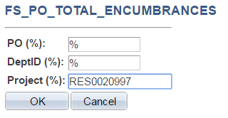
PeopleSoft Queries

Slide 18
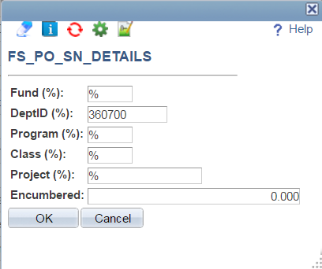
PeopleSoft / eTRAC Inquiry and Reporting
SupplyNet Transactions only – Line Details on Remaining Encumbrances or All Orders

Slide 19
Opportunities
Simplify your internal procurement process
Minimize duplicate entry
Automate workflow and approvals
Reduce paper handling and records management
Reduce amount of time tracking documents; i.e. invoices
Go “Green”
Use Online Receiving functionality; no paper packing slips
Use “Attachment” functionality
Records retained online versus paper files
Notes:
SupplyNet will minimize duplicate entry, automate workflow and approvals while reducing paper handling and records management not to mention the amount of time wasted tracking down paper.

Slide 20
Project Schedule & Rollout
Roll-out Dates | Groups
May 16, 2016 | Information Services & Technology
May 30, 2016 | Facilities & Operations
June 13, 2016 | Faculty of Science
June 27, 2016 | Remaining Faculties and Departments
Notes:
Training is aligned with roll-out. For General Users, instructor led classroom training sessions will begin the week of May 30th and run for 5 weeks, 2 sessions per week.

Slide 21
Roll-Out
Roll-out Package will be distributed to each Faculty:
Security Spreadsheets to assist with set-up in SupplyNet
Listing of SupplyNet Users who will be automatically set-up in SupplyNet (Budget Owners and Departmental Requesters)
FY2016 Transaction Detail for Faculty Review
SMS to assist Departments as required with Roll-Out

Slide 22
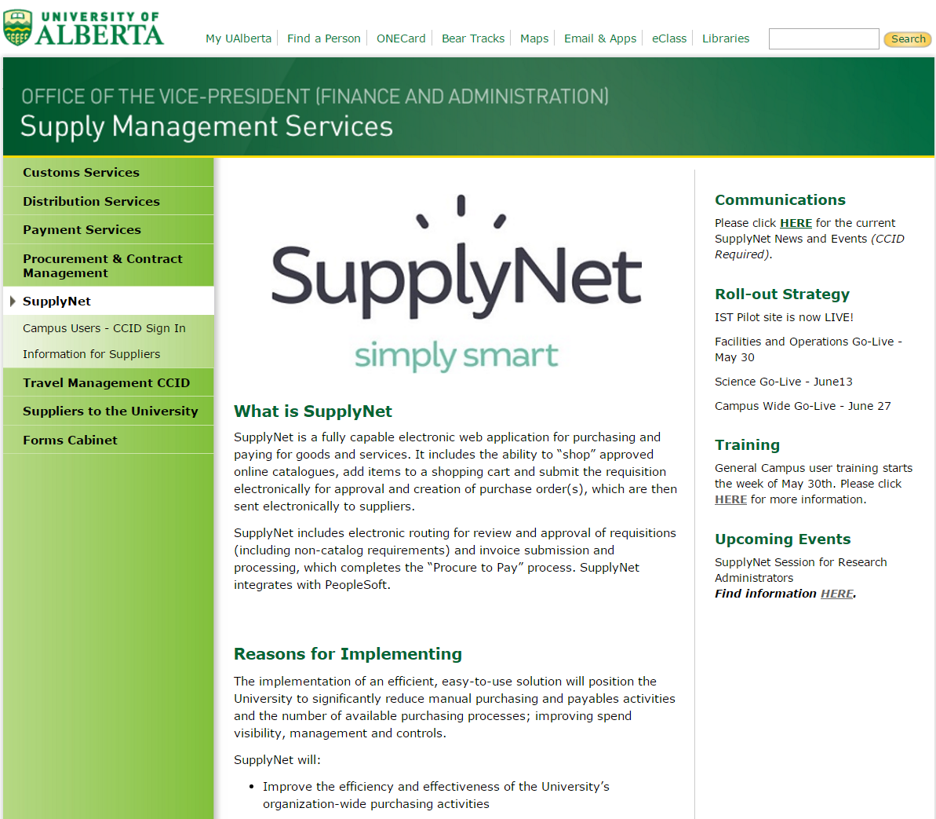
SupplyNet - www.sms.ualberta.ca

Slide 23
Notes:
Check our SupplyNet website: Find project information, training materials, SupplyNet Login, contact information. Campus User CCID login.

Slide 24
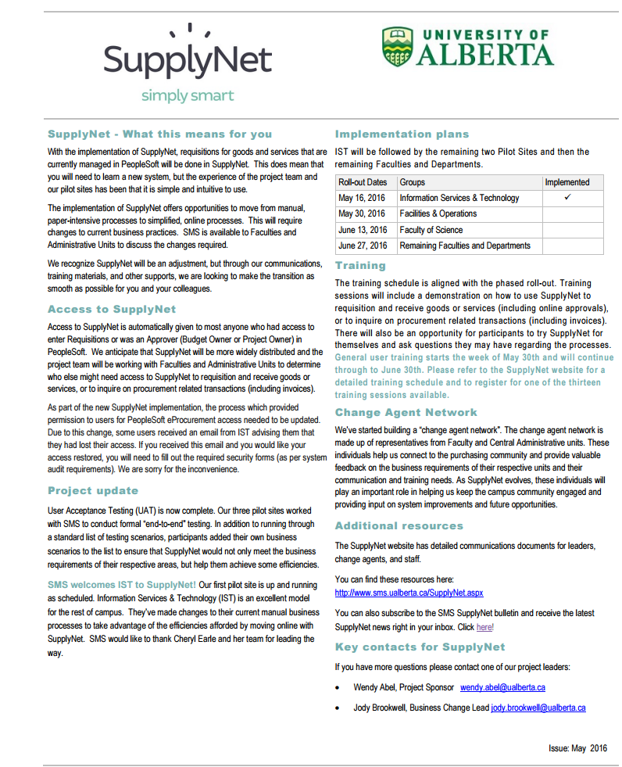
Subscribe to the SupplyNet Newsletter for project updates, new Preferred Suppliers, and new features!
Notes:
Subscribe to the SMS SupplyNet bulletin to receive the latest SupplyNet news direct to your inbox.

Slide 25
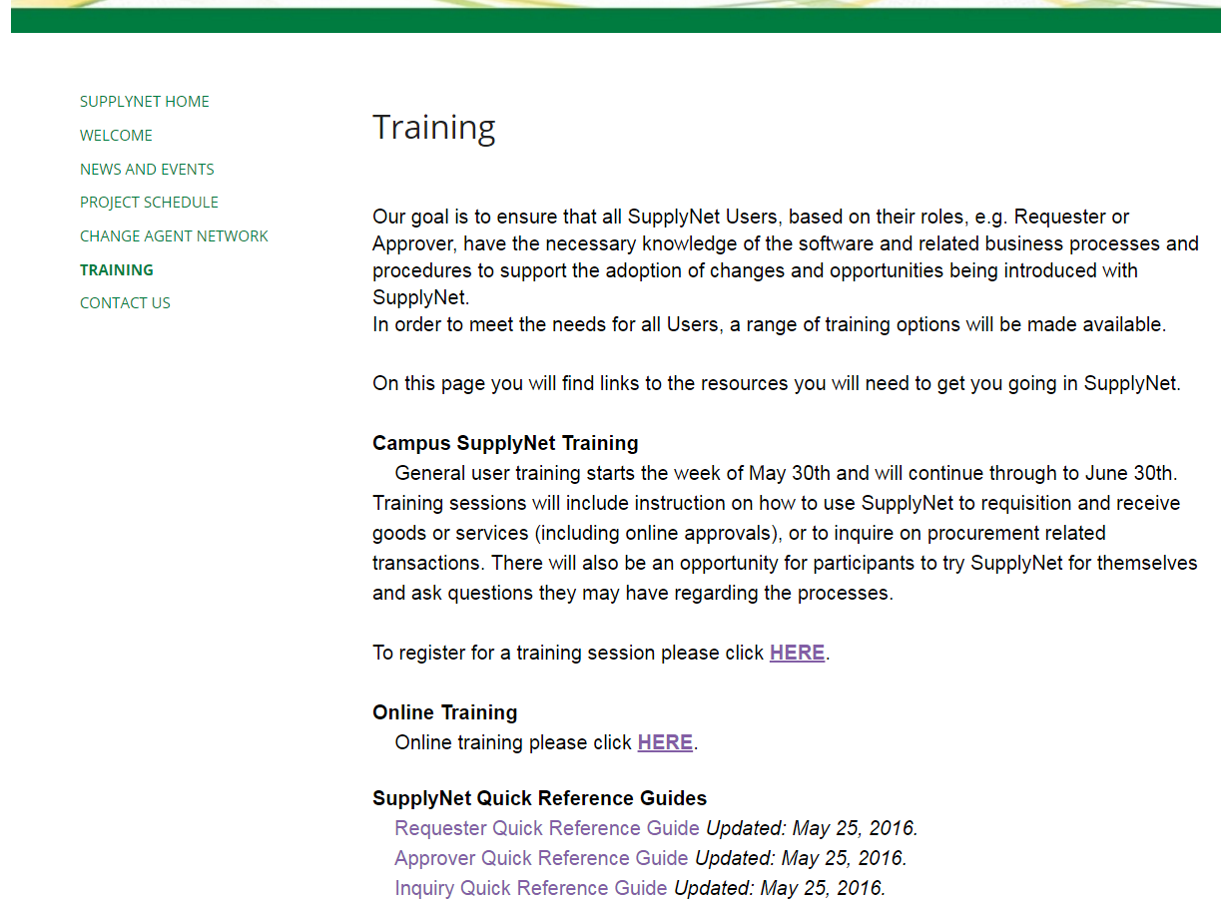
Notes:
Check our SupplyNet website: Find project information, training materials, SupplyNet Login, contact information. Campus User CCID login.

Slide 26
Contact Name | Contact Role | Contact Email Address
Wendy Abel | Project Sponsor | wendy.abel@ualberta.ca
Jody Brookwell | Business Change Lead | jody.brookwell@ualberta.ca

Slide 27
QUESTIONS ?

Slide 28
Online Evaluation Form
We appreciate your help in evaluating this presentation!
The RAD evaluation form is accessible online. Click here or click on the blue checkmark below (right-click the hyperlink(s) and click Open Hyperlink to activate).

