Slide 1
PeopleSoft HCM Upgrade – What it means to you
RAD 302
Terry Harris, PMP, Senior Program Manager, Information Services and Technology (IST) and Fatima Mirza, Director, HR Operations. Human Resource Services

Slide 2
Agenda
Project Overview
Scope Highlights
Community Engagement
Training
Functionality Walk-through

Slide 3
Overview
Business Objectives
Re-examine foundational principles
Position PS HCM for the future
Simplify and streamline processes
Provide better access to information
Reduce customizations and associated costs
Reduce manual effort; shift to strategic activities
Core Principles
Supports Institution-wide programs & services
Consistent business processes
Replace customizations where possible
Supports the implementation of SE² business improvements
Provides continued application support and maintainability

Slide 4
Overview
Project Recap
Upgrade – version 9.0 to 9.2
Improve and automate business processes by leveraging available functionality
Implement new features
Improve Smart Forms and implement additional forms
Replace customizations with delivered functionality
Enable the capability to host other institutions
Update the user security model
This is not your regular upgrade!
Significant changes beyond upgrading the core software
Directly impacts almost all staff groups
Requires a close working relationship among Human Resource Services, Departments/Faculties and IST to be successful

Slide 5
Scope Highlights – Human Resources
HR Taxonomy changes - Regular/Temporary, Full/Part time, employee class, union code
Job codes - simplified
Define reporting relationships - Reports to position / Supervisor ID
HR eApplications (Bear Tracks) - look and feel
Manager Dashboard - NEW

Slide 6
Scope Highlights – eForms
Redesign existing forms
Reflect changes to HR taxonomy
Broaden form use to include additional transactions affecting Academic staff
Improve user experience
No significant changes to business processes

Slide 7
Scope Highlights – Benefits
Benefits Administration
Automated application of benefit eligibility rules
eBenefits
Online benefit coverage selection – hire, rehire, life events

Slide 8
Scope Highlights – Integration
Common Configuration
Use of SpeedCodes and full chartfield strings within HCM is changing
Commitment Accounting
Suspense process
Account mapping; fewer payroll accounts
Detailed transaction lines in HCM; GL receives aggregate only
GL Redistributions
New processes being developed

Slide 9
SpeedCodes
Will be used for data entry on eForms and by HRS only
The speedcode-account will not be stored however will translate into the full chartfield string which will be stored within HCM. Similar to PS Finance.
81850-500011 becomes: FUND / DEPTID / ACCOUNT / PROGRAM / CLASS / PROJECT / SPONSOR 530 / 720600 / 500011 / 0000 / 0000 / RES00002 / 0000
Speedcode will display beside full chart string on HCM financial Operational reports.

Slide 10
Account Mapping
No need to enter accounts in chart field
System uses HR taxonomy values to determine which account to use
Consolidated to simplify and reduce number of accounts
One-to-one relationship between type of employee and account to ensure consistency

Slide 11
TEEF / TABS
Trustholders Extraordinary Expense Fund
Trust Academic Benefits Stabilization Fund
Today
Deductions are calculated when GL runs
Unable to see details in PeopleSoft HCM
HCM 9.2
Payroll calculation – will be able to see details within HCM
Employees will see it on their paycheque as an employer-paid benefit

Slide 12
Suspense Processing
Closed or inactive chart fields will push GL accounting transactions to suspense account in fund 210 at department level.
Processes will identify errors before Payroll is confirmed and actuals are generated
Departments will be responsible for addressing issues, otherwise errors will go to Department suspense accounts (no longer HRS)

Slide 13
Scope Highlights – Time and Labour
Employee time entry (self-service)
Support staff
Hourly (positive time) and monthly (exception time)
Same timesheet format for both
Tied to leave accruals/balances
Existing processes will be available, if required

Slide 14
Scope Highlights – Time and Labour
Time approvals
System approvals required for time entered online by employees
Delegation functionality available
Time Manager role (new)
Reporting, alerts, notifications
Time Keeper role
Available, if required

Slide 15
Scope Highlights – Time and Labour
All roles responsible for reviewing and addressing exception errors
Operating vs Trust
Overarching goal is to develop consistent business processes wherever possible
Working with Research Service Office and Financial Services to define

Slide 16
Scope Highlights – Security/Access
Permission list and user role redesign
Distributed Access will be replaced by direct access to the source pages within PeopleSoft
Users will have access to both Academic and Non-Academic staff records

Slide 17
Engagement
HCM Upgrade Advisory Committee
Regular meetings
Topic-specific workshops/meetings
Regular updates to various University committees
Admin Strategic Council, Finance Management Committee
IT Steering Committee – Administration
Meetings with specific Faculties/Admin Units and other constituent groups (e.g., URAC)
User Acceptance Testing
Training

Slide 18
Training Approach
Online materials – UPK (“click-through” demo), slide decks, quick reference guides
Information sessions before go-live – HR Contacts, eForm Originators, Supervisors
Drop-in sessions after go-live – HR Contacts, eForm Originators, Supervisors, Employee Time Entry
Schedule will be made available when implementation date is confirmed

Slide 19
Functionality Walk-through
Work in progress

Slide 20
Time Entry and Approval Overview
Change Highlights:
Online access through self-service allowing users to enter/review time and absences
Online Approval and Time Management reporting
Develop a foundation to enhance Time Entry/Management functionality in the future
Implement leading practices
Notes:
Key Functionality
Employee ability to enter their own time on-line
Online approval with workflow notification to advise Approvers that time is ready for approval
Access to online views or queries of time reports
Time & Labour WorkCentre

Slide 21
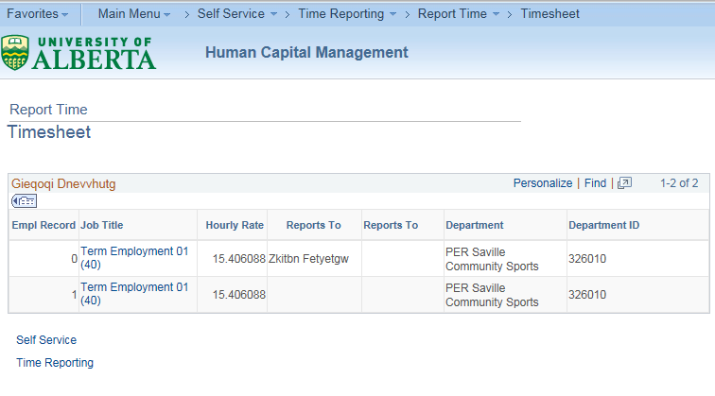
Employee Time Entry
Notes:
Employees with multiple jobs will be able to select the job that they are entering time for.

Slide 22
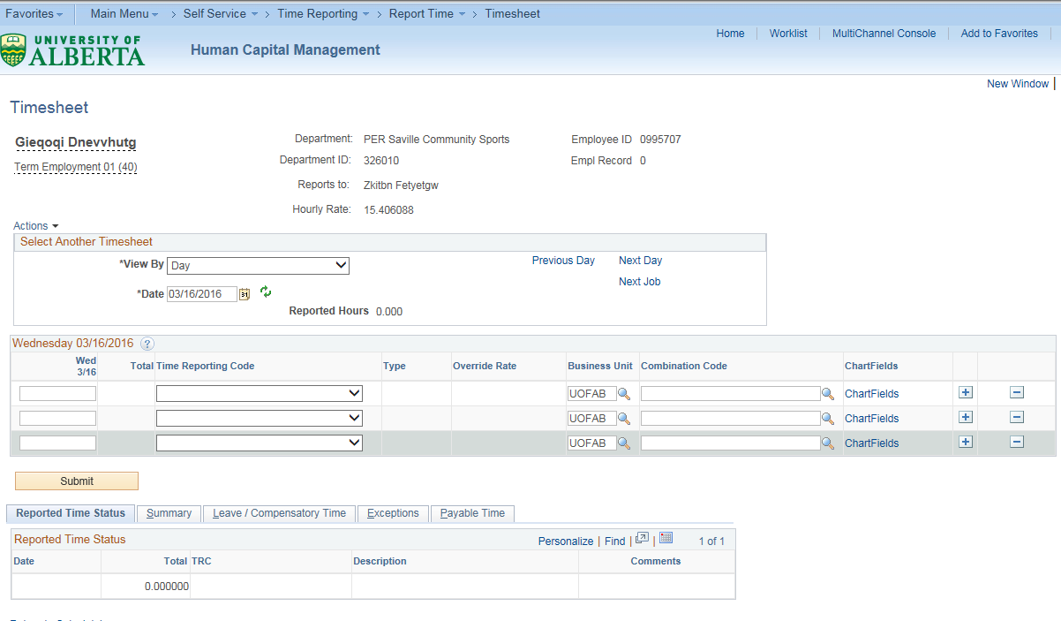
Employee Time Entry
Notes:
Once the employee time sheet comes up the employee can choose the view time for the entire pay period (calendar period), a one week period, or for a single day. Calendar period is the default setting.
Employee’s can enter comments specific to daily time entry.

Slide 23
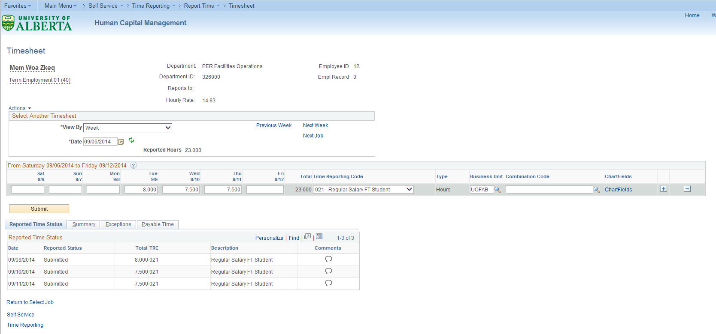
Employee Time Entry
Notes:
View by week

Slide 24
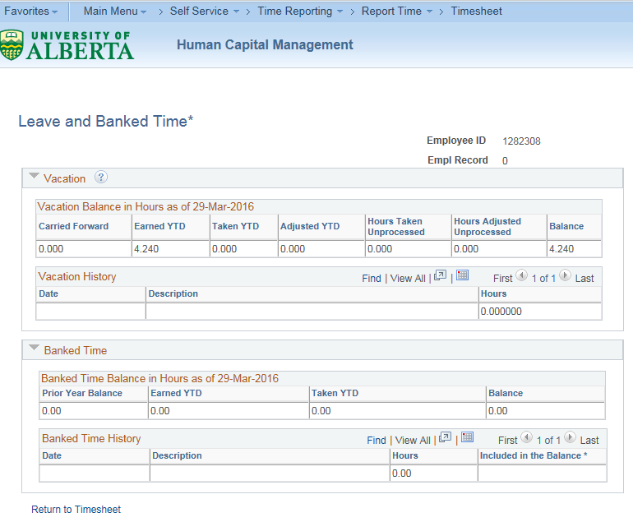
Employee Time Entry Walkthrough
Notes:
Employees will be able to view balances and time taken for compensatory time and vacation leave.

Slide 25
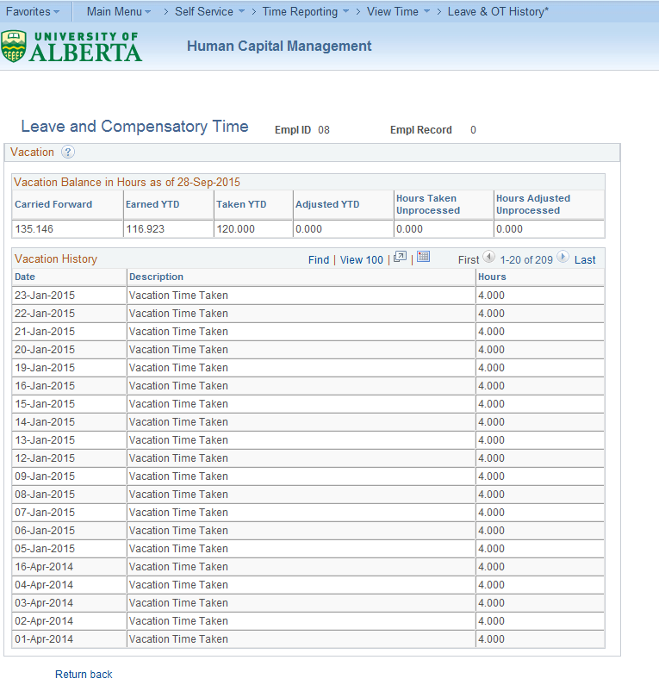
Employee Time Entry
Notes:
Employees will be able to view balances and time taken for compensatory time and vacation leave.

Slide 26
Time Entry Approval
Approver Assignment Workflow
Automatically assigned, based on:
Nightly process runs to reflect changes in reporting relationships
HR Information
Reports
To
Not Found
Workflow Administrator
Supervisor
ID
Department Manager
Not Found
OR

Slide 27
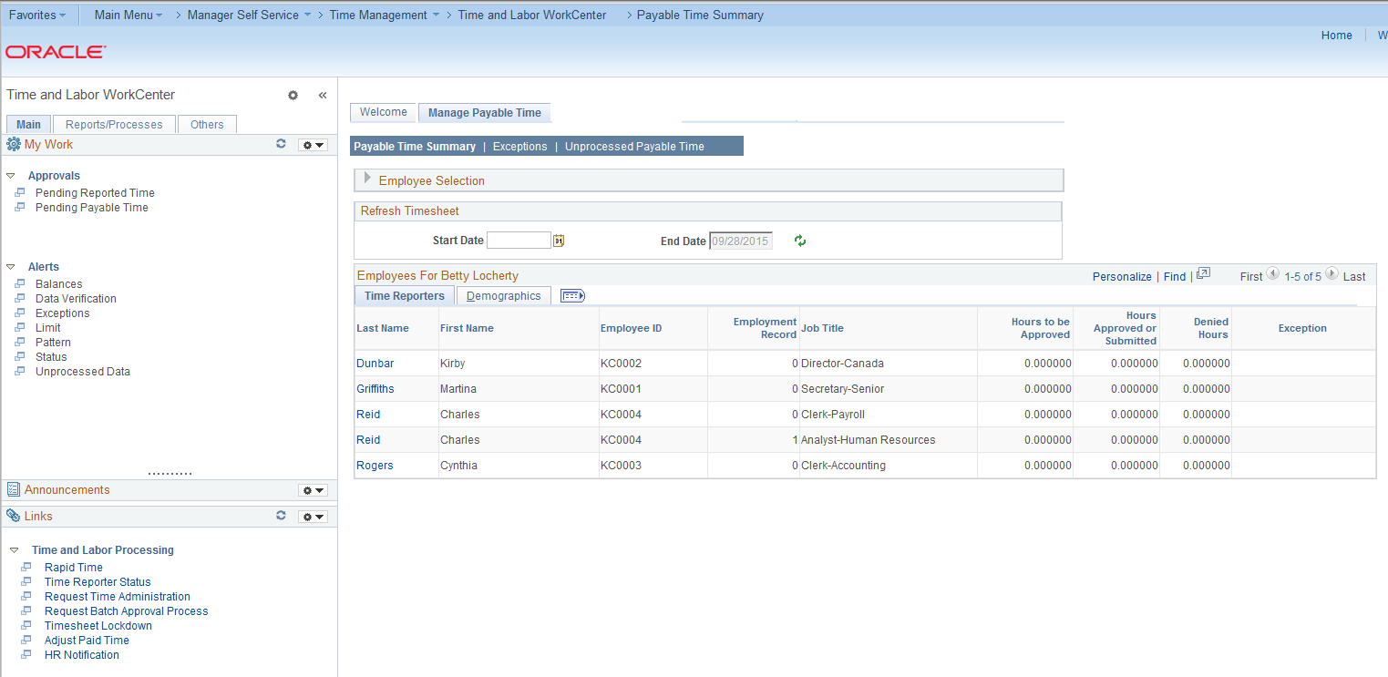
Time Entry Approval
Notes:
Workflow notification will advise approvers that time is waiting for approval.
Time approvers will have access to a Time and Labour WorkCenter to provide access to time that is waiting for approval, alerts that have been generated, and reports that they can run to review time related information for their employees.

Slide 28
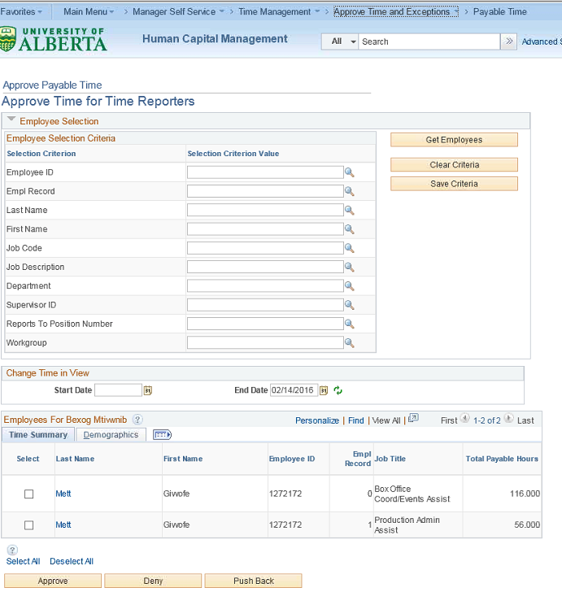
Time Entry Approval
Notes:
Approvers will see a summary of the time that is awaiting approval and can drill down to the details. They can choose the approve, deny or pushback the time at the summary level or when they drill down to the specific detail.

Slide 29
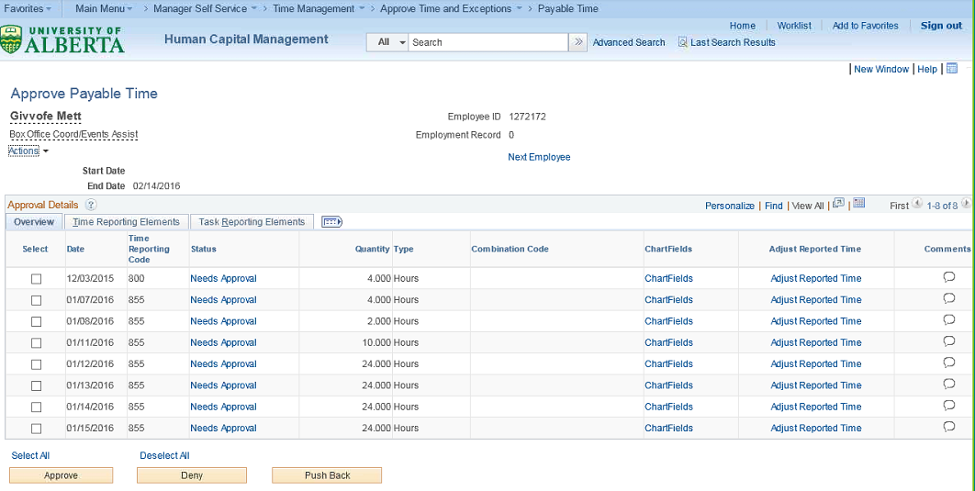
Time Entry Approval
Notes:
When drilling down to the detail, the approver will be able adjust reported time and see employee comments or add their own. There is discussion about the use of Deny. Potential of inactivating this option.

Slide 30
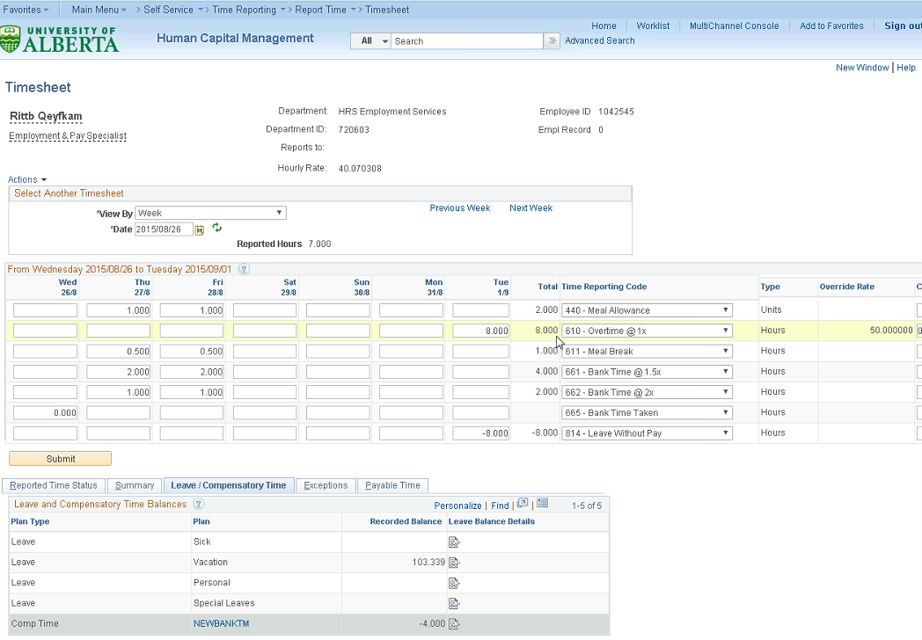
Time Entry Approval
Notes:
If the approver is adjusting reported time, they will see the same time sheet that employees see.

Slide 31
Suspense Process
Final Mode
Edit Mode
Runs nightly during a semi-monthly or monthly processing night
Final Pay Calculation PSPPYRUN.CBL
Runs on the night of confirm for semi-monthly and last day of month for monthly
Pay Calculation
PSPPYRUN.CBL
Pay Confirmation
PSPCNFRM.CBL
This process allows for suspense resolution in HCM prior to the generation of payroll journals in Finance
Distribute Actuals Edit Mode
ZPYADEM
Actuals Distribution
PSPPFUND
Suspense Distribution Edit Mode
ZGL_SUSPDIST
Allows for distribution to be updated to suspense if not resolved prior to the GL interface
Suspense Distribution Final
ZGL_SUSPDIST
Suspense Distribution Email
ZGL_SUSPMAIL
G/L Interface
PAYGL02.SQR
Notes:
Process runs in “edit” mode during pay calc cycle – budget owner gets notification that something is about to go into suspense
Receives notification every day that pay calc runs until the issue is resolved
When pay confirm is run, suspense is run in “final” mode – Department must determine what to do with it

Slide 32
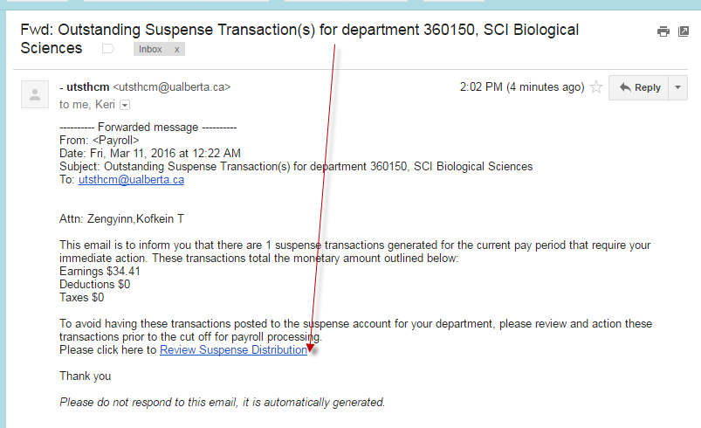
View Suspense Distribution
Notes:
Department will receive this e-mail. When you click on the link it will take you to the following page.

Slide 33
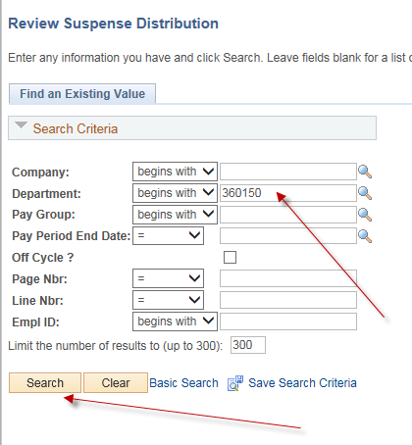
View Suspense Distribution
Notes:
Enter the department ID indicated in the subject line of the e-mail. Click on search and it will bring you to the transactions that are in suspense. In this case, there is only one. If there were several for the same department, the search results would show the list and you would select the specific transaction you want to review.

Slide 34
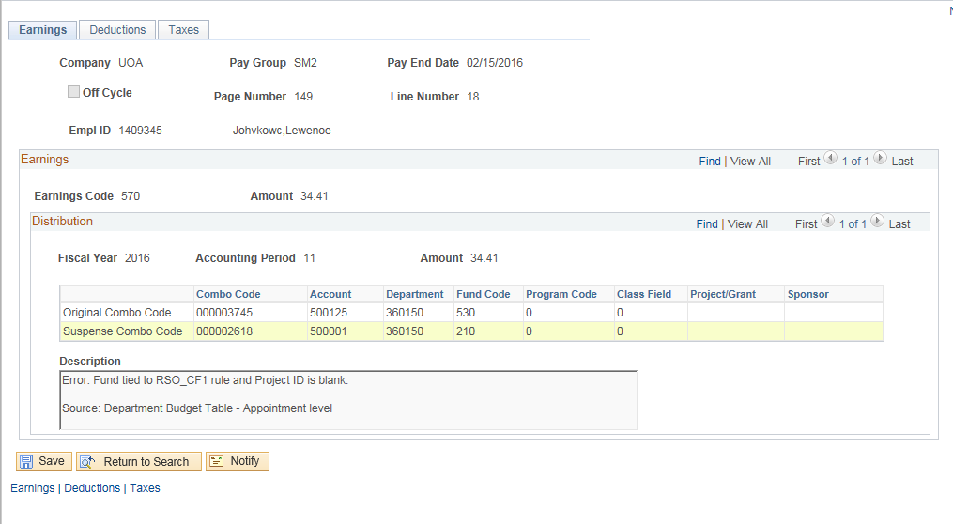
View Suspense Distribution

Slide 35
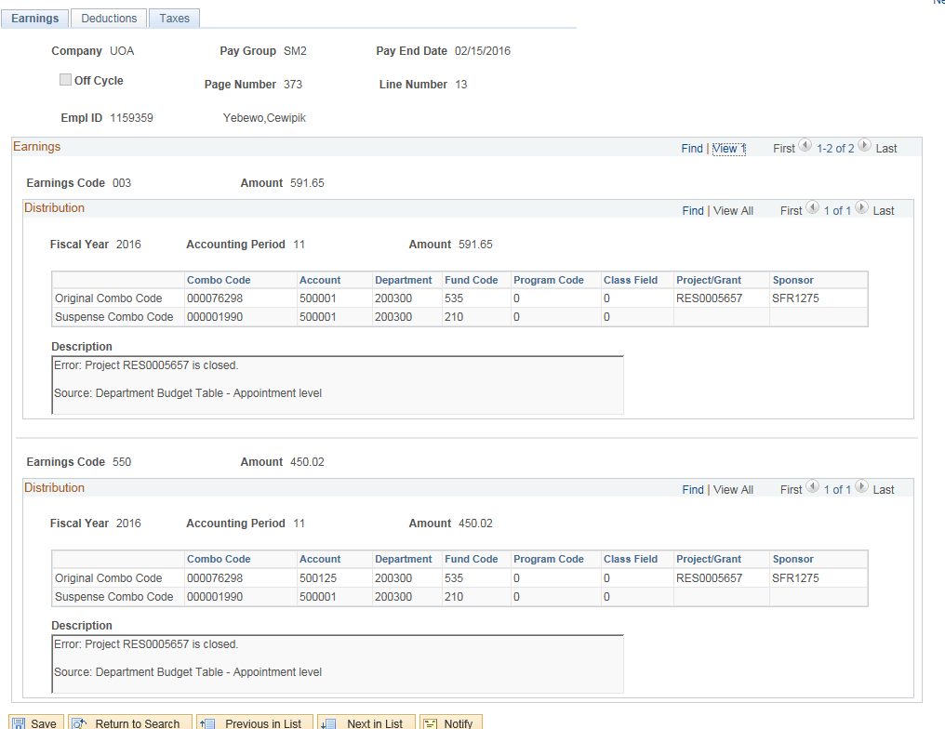
View Suspense Distribution
Notes:
If you had multiple errors, this is what the page would look like.

Slide 36
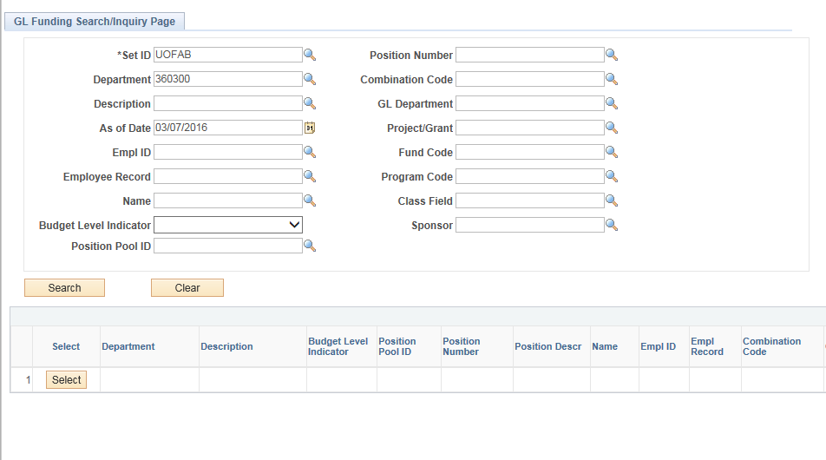
View GL Funding
Notes:
View GL Funding can be used to proactively look at who is being charged where – e.g., plan ahead if project is about to expire

Slide 37
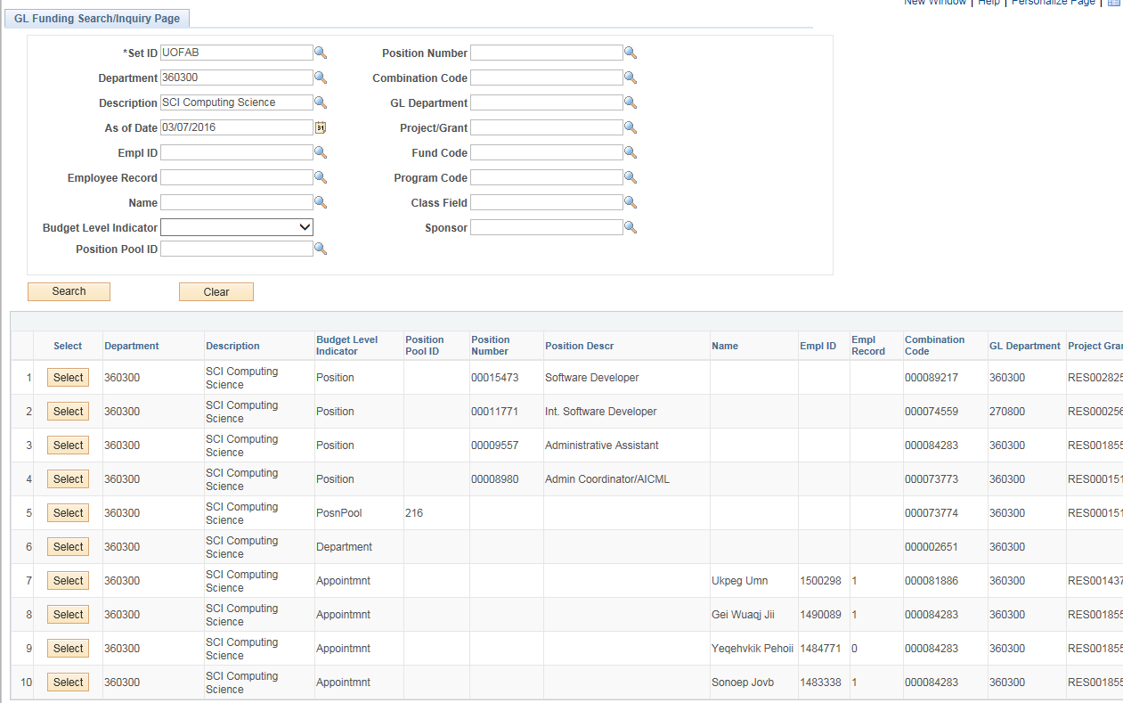
View GL Funding

Slide 38
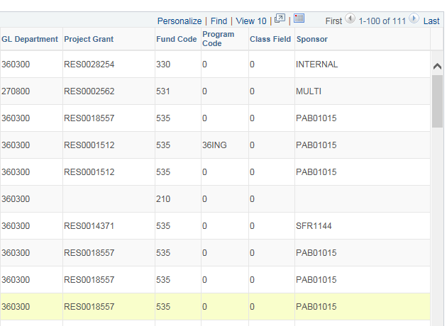
View GL Funding

Slide 39
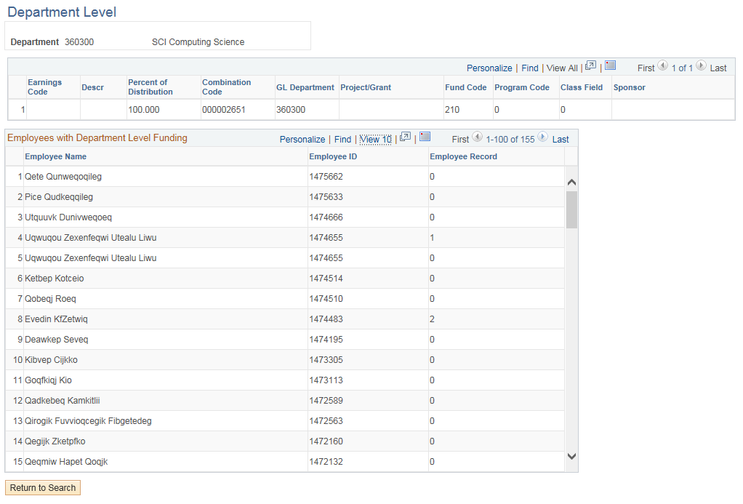
View GL Funding

Slide 40
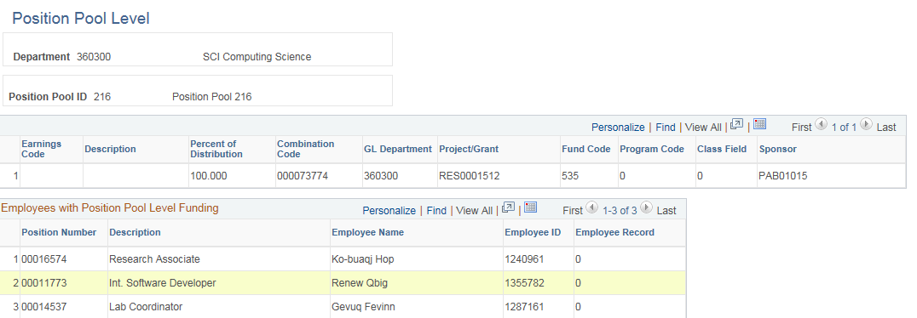
View GL Funding

Slide 41
Project Contacts
Wayne Patterson – HR Business Sponsor/Lead
Terry Harris – Change Lead
Alex Necheff – Project Manager
Project information is available on the HRS Service Excellence and Efficiency (SE2) website - http://se2.ualberta.ca/

Slide 43
Online Evaluation Form
We appreciate your help in evaluating this presentation!
The RAD evaluation form is accessible online. Click here or click on the blue checkmark below (right-click the hyperlink(s) and click Open Hyperlink to activate).

