Slide 1
What Makes a CFI Proposal or Award so “Special”? Research Administration Day, May 31, 2017 “Today’s Research, Our Future” Partnership and Institutional Projects, Research Services Office Kara Allanach, Manager Institutional Projects Nancy Klimczak, Assistant Director
RAD 202

Slide 2
Topics:
Welcome and Introductions
What is the Canada Foundation for Innovation?
Key CFI Guidelines
CFI vs. Typical research proposals
Budgets: CFI “In-kind” contributions
Construction/Renovation requirements
Environmental Scan: Integration with existing infrastructure
Lessons learned from reviewer comments
QUESTIONS

Slide 3
Who are we? The Institutional Projects Team
Campus Unit | Name | Role | Phone | E-mail
RSO | Nancy Klimczak | Assistant Director, Partnership & Institutional Projects | 780-492-1452 | nancy.klimczak@ualberta.ca
RSO | Kara Allanach | Manager, Institutional Projects | 780-492-8936 | kara.allanach@ualberta.ca
RSO | Gareth Corry | Contracts Specialist | 780-492-8032 | gcorry@ualberta.ca
RSO | Mireille Estephan | Contracts Specialist | 780-492-8378 | mireille.estephan@ualberta.ca
RSO | Liz Huston | Contracts Specialist | 780-492-1430 | liz.huston@ualberta.ca
RSO | Ryan McKenzie | Contracts Specialist | 780-492-6154 | ryan.mckenzie@ualberta.ca
RSO | Gonzalo Vilas | Contracts Specialist | 780-492-2753 | gonzalo.vilas@ualberta.ca
RSO | Vera Harris | Research Support Administrator | 780-492-8566 | vera.harris@ualberta.ca
RSO | Esther Yeung | Research Support Administrator | 780-492-2922 | eyeung@ualberta.ca
RSO | Lisa Cruywels | Research Support Administrator | 780-492-8623 | cruywels@ualberta.ca
RSO | Vanessa Incani | Research Support Administrator | 780-492-2406 | vincani@ualberta.ca
F&O | Asia Szkudlarek | Project Cost Analyst - CFI | 780-492-1166 | aszkudlarek@ualberta.ca

Slide 4
Who are we? The Institutional Projects Team
The Institutional Projects team is involved with each CFI project throughout its entire lifetime
We provide support for:
Proposal Development
Budget Development
Award Finalization
Negotiation of Agreements
Review and Approval of all purchases >$10K
Reporting
Project Closure
Audit Support (if applicable)

Slide 5
What is CFI?

Slide 6
Canada Foundation for Innovation
Independent corporation, founded in 1997
Receives funding from the Federal Government
CFI’s Mandate:
To make financial contributions to Canada’s universities, colleges, research hospitals and non-profit research organizations to increase their capacity to carry out high quality research.
“Allocation” or “Envelope”

Slide 7
Canada Foundation for Innovation: Objectives
Increase Canada’s capability to carry out world-class scientific research and technology development
Support economic growth and job creation, as well as health and environmental quality through innovation
Expand research and job opportunities by providing support through research infrastructure for the development of highly qualified personnel
Promote productive networks and collaboration among Canadian institutions and the private sector

Slide 8
CFI Awards are Institutional Awards
CFI projects are awarded to the institution, rather than to faculty members
The PI is the Project Leader
Vice President (Research) is the Project Holder
CFI funds the acquisition of infrastructure, not research
The Institution has a contractual obligation to manage all CFI funds in accordance with CFI policies
CFI carries out regular audits and monitoring visits
Non-compliance on a single project can result in widespread effects on all institutional CFI funding

Slide 9
CFI Award Funding Structure
CFI funds maximum 40% of Total Project Costs (TPC)
Request can be made to Ministry of Economic Development and Trade (EDT) for additional 40% of TPC
Remaining 20% to come from other sources:
Eligible partners
Vendor in-kind contributions
Institutional contributions

Slide 10
Partner Contributions
Eligible Partners:
Institutional funds
Most departments/agencies of the federal and provincial governments
Industry partners (unless already matched)
Non-profit organizations
Individuals
Non-eligible Partners:
CIHR
NSERC
SSHRC
NCE
CRC
***Not an exhaustive list.

Slide 11
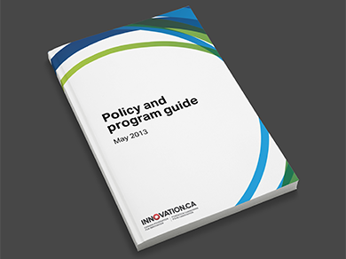
Canada Foundation for Innovation Key Guidelines
Changes to the Infrastructure
“The CFI funds specific items of an infrastructure project that have been subject to a merit-based review.
As such, the institution is expected to use CFI funds to purchase the infrastructure items identified in the proposal.”
--CFI Policy and Program Guide, Sec. 6.6.1
However,
Both CFI and the institution recognize that technology continues to develop and changes are sometimes inevitable.
Therefore:
**Institutional review is required for all changes**

Slide 12
Canada Foundation for Innovation Key Guidelines
Eligible Costs:
Acquisition and installation of infrastructure (including databases)
Construction and renovation costs required to house the CFI-funded infrastructure
Operations and maintenance of CFI-funded infrastructure (including HQP salaries)
Ineligible Costs:
Any cost to conduct research activities
Trainee stipends or researcher salaries (students, post-doctoral fellows)
Infrastructure primarily used for teaching or clinical care
***this is a non-exhaustive list

Slide 13
Comparison: Typical Operating Proposal vs. CFI Proposal

Slide 14
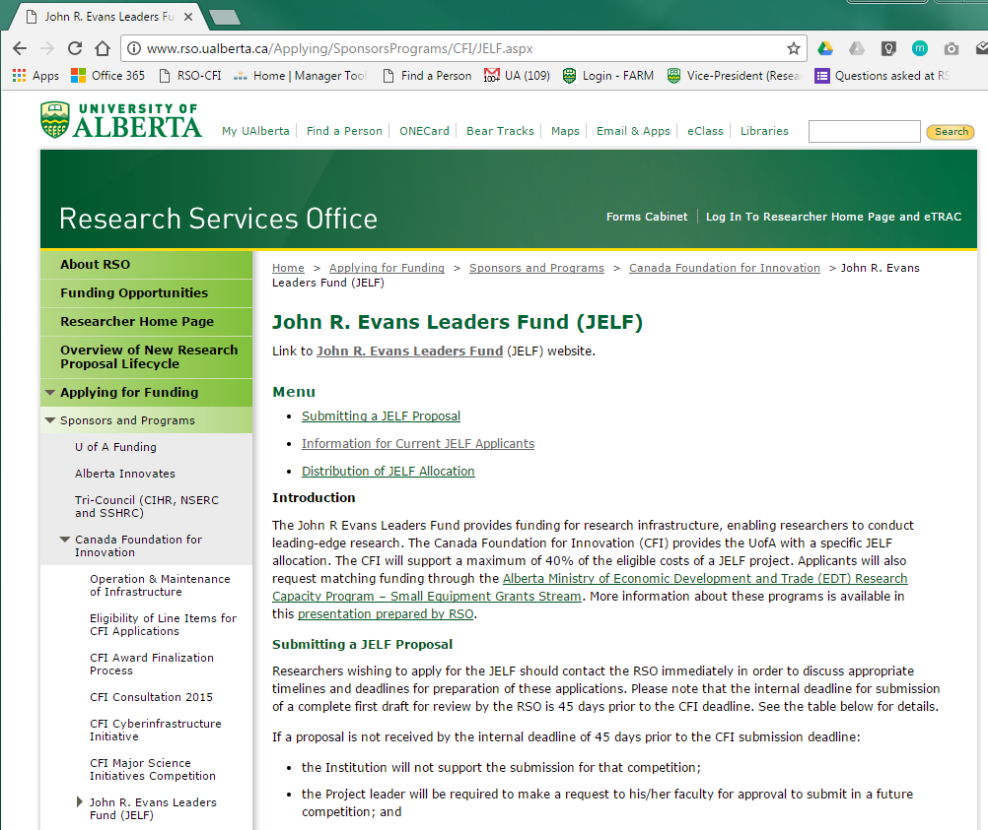
For detailed information about CFI JELF proposal development: http://www.rso.ualberta.ca/Applying/SponsorsPrograms/CFI/JELF.aspx

Slide 15
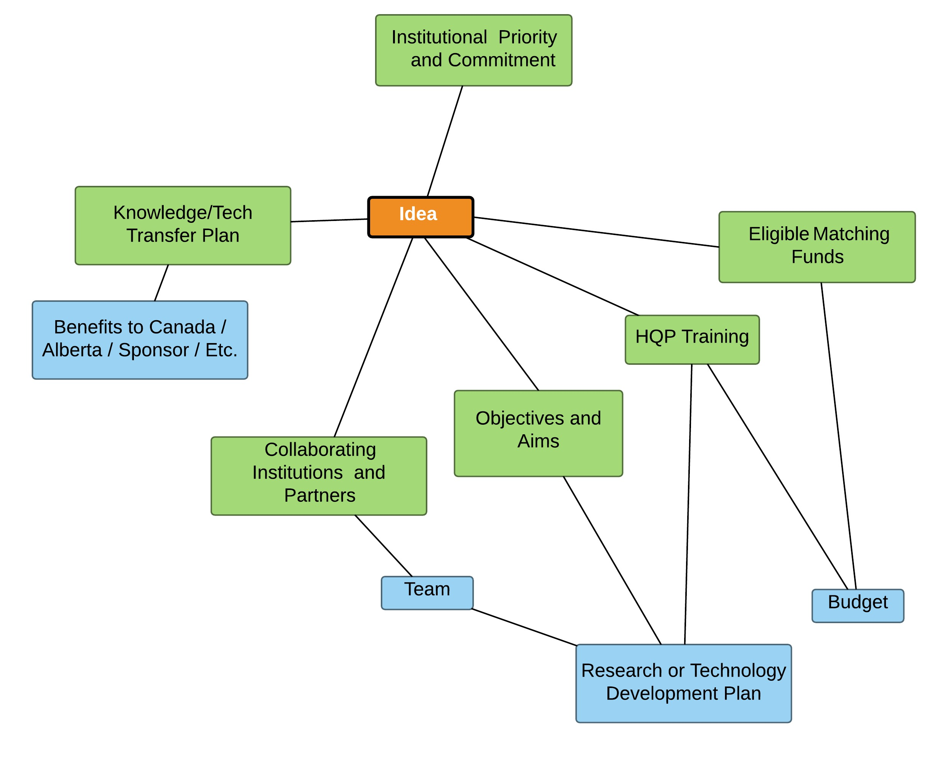
Proposal Development Process: “Typical” (operating) Grant
Institutional Alignment
Future Benefits
Budget
Research Plan

Slide 16
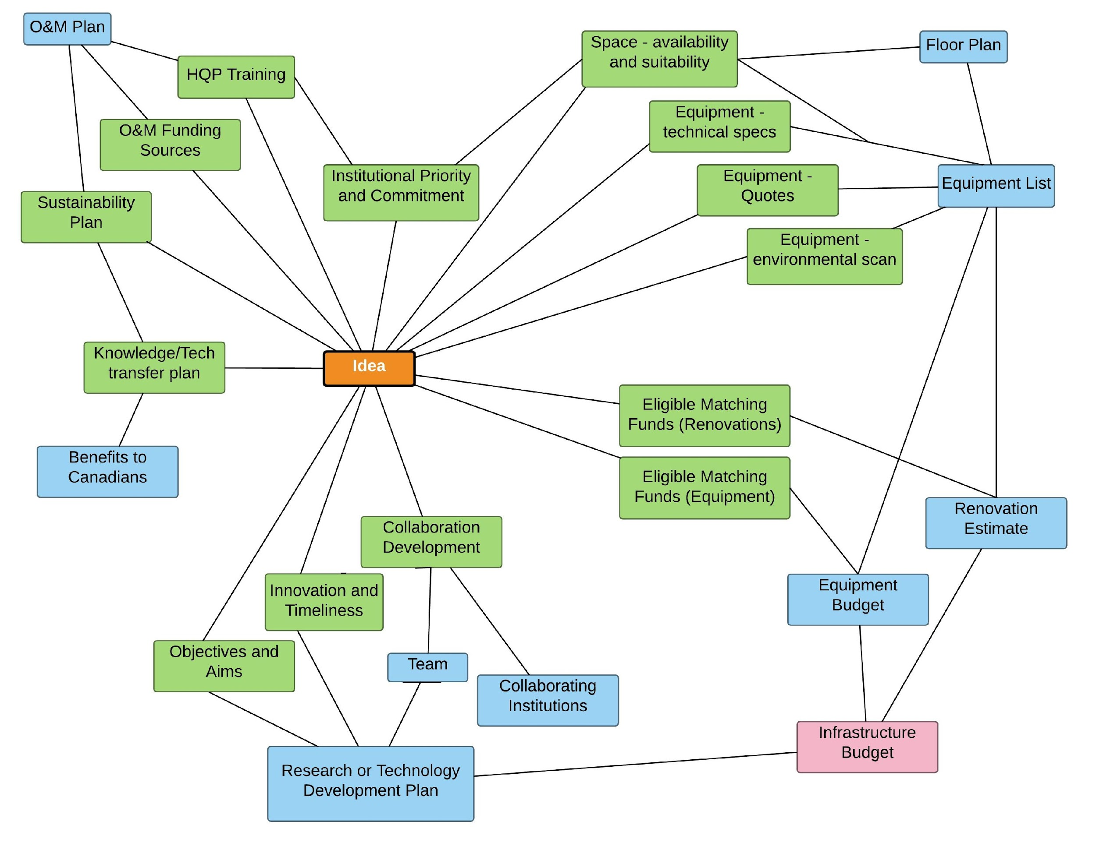
Proposal Development Process: CFI Projects
O&M and Sustainability Plan
Institutional Alignment
Space and Equipment Plan
Future Benefits
CFI Proposal
Infrastructure Budget
Research Plan

Slide 17
Proposal Development Process: CFI Projects
O&M and Sustainability Plan
Institutional Alignment
Space and Equipment Plan
Future Benefits
CFI Proposal
Infrastructure Budget
Research Plan

Slide 18
Space Modifications: CFI Process From a Planning Perspective
Site Review &
Scope of Work
Identify
Space
Equipment
Specifications
Concept Drawings
Project Timelines
Cost Estimate
NO
Is the Space
Appropriate?
YES
Final Estimate for Proposal

Slide 19
Proposal Development Process: CFI Projects
O&M and Sustainability Plan
Institutional Alignment
Space and Equipment Plan
Future Benefits
CFI Proposal
Infrastructure Budget
Research Plan

Slide 20
Budget Development In-kind Contributions
The CFI considers the Fair Market Value (eligible cost) of an item to be the price of the item after normal and/or educational discounts
Normal discount: A discount a supplier would normally apply to anybody
Educational discount: A discount offered to an institution due to its educational status.
Eligible in-kind contribution: A non-monetary resource offered as a contribution toward a CFI-funded project. The eligible in-kind contribution is equal to the fair market value of the item less the net selling price (if any). Must be over and above Normal and Educational Discounts
* Ref: Section 6.5 (page 45) in CFI’s Policy and Procedure Guide, 2013

Slide 21
Budget Development In-kind Contributions
Important notes about in-kind contribution:
No in-kind provided on renovations
Vendors are not required to offer normal or educational discounts
May ask for an in-kind contribution from suppliers but do not ask for a specific amount or percentage*
*https://www.innovation.ca/sites/default/files/vpupdate/cfi-vp-update-july-2016.pdf
*https://www.innovation.ca/sites/default/files/Funds/documents/Competitivie%20bid%20process%20and%20examples_updated%20April%207_2014_EN%20-%20CSV2.pdf

Slide 22
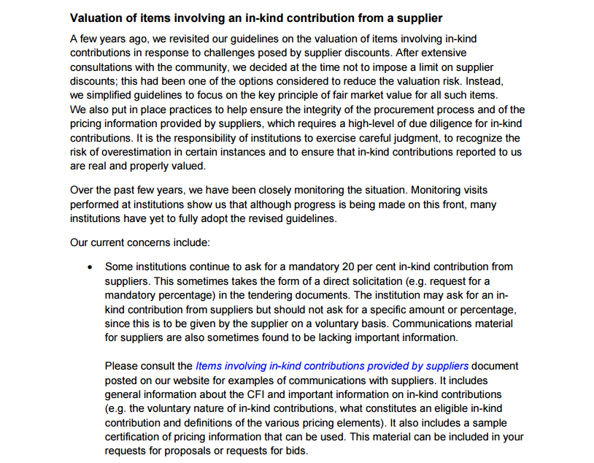
https://www.innovation.ca/sites/default/files/vpupdate/cfi-vp-update-july-2016.pdf
Budget Development In-kind Contributions

Slide 23
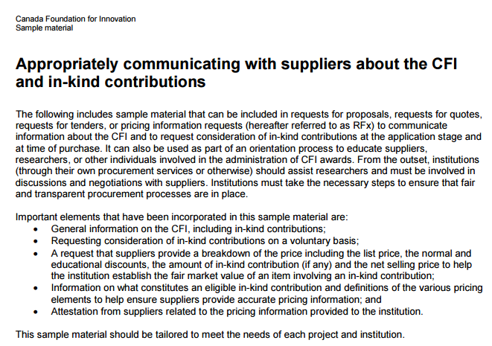
Budget Development In-kind Contributions
*https://www.innovation.ca/sites/default/files/Funds/documents/Competitivie%20bid%20process%20and%20examples_updated%20April%207_2014_EN%20-%20CSV2.pdf

Slide 24
Proposal Development Process: CFI Projects
O&M and Sustainability Plan
Institutional Alignment
Space and Equipment Plan
Future Benefits
CFI Proposal
Infrastructure Budget
Research Plan

Slide 25
Proposal Development Process: CFI Projects
IMPORTANT:
If you are working on a CFI proposal with a collaborator from another institution, even if UofA is not the lead you must contact you Department, Faculty and RSO as soon as possible.
O&M and Sustainability Plan
Institutional Alignment
Space and Equipment Plan
Future Benefits
CFI Proposal
Infrastructure Budget
Research Plan

Slide 26
Proposal Development Process: CFI Projects
O&M and Sustainability Plan
Institutional Alignment
Space and Equipment Plan
Future Benefits
CFI Proposal
Infrastructure Budget
Research Plan

Slide 27
Proposal Development Process: CFI Projects
O&M and Sustainability Plan
Institutional Alignment
Space and Equipment Plan
Future Benefits
CFI Proposal
Infrastructure Budget
Research Plan

Slide 28
www.rso.ualberta.ca/Applying/SponsorsPrograms/CFI/OM.aspx

Slide 29
Infrastructure Operating Funds (IOF)
Additional funds provided for direct, incremental operating expenditures
Salaries, training, extended warranties, maintenance/repairs, replacement parts, supplies, services to support infrastructure
Researchers can access to up to 25% of finalized CFI award amount
e.g., $1M TPC = $400K CFI = $100K IOF
Not a competition; researcher sends request to RSO to open IOF project

Slide 30
Proposal Development Process: CFI projects
O&M and Sustainability Plan
Institutional Alignment
Space and Equipment Plan
Future Benefits
CFI Proposal
Infrastructure Budget
Research Plan

Slide 31
Institutional Submission Requirements
UofA “Suite” of Proposals
strategic decisions
coordinated request
maximized envelope

Slide 32
CFI Proposal Development: Communications
VP Facilities & Operations
VP Research
VP Academic
F&O
PMO
RSO
Faculties
Director
Dean
Assistant Director
ADR
CFI Coordinator
Departments
CFI Liaison
Chair
Space Planners
Researcher (Project Lead)
Estimators
Contracts Specialists
Co-PIs
External
Writers
Collaborating Institutions

Slide 33
Post-Award Activities

Slide 34
PI and/or Support administrator
RSO
SMS
RSO
SMS
PI and/or Support administrator
Attaches CFI quote
Identifies CFI line item
Creates PR for bid RSO
Reviews PR
Approves PR for bid
PI
RSO reviews and approves PR
SMS proceeds with the award and contract execution
SMS issues PO
Competitive Bid:
SMS/PI develop and evaluate Request For Proposal (RFP)
SMS provides proposal responses to RSO
PI edits, updates and approves PR
https://policiesonline.ualberta.ca/PoliciesProcedures/Procedures/Competitive-Bid-Procedure.pdf

Slide 35
Expenditure Monitoring
e-TRAC Download
Line item Identification
Eligibility Review
Issues Resolution
Projects expenses for quarterly periods are downloaded from eTRAC
F18 Q1 Q2 Q3 Q4
Excel spreadsheets are sent to the PI for review
Confirm expenses
Add missing line numbers
CFI policy guidelines eligibility
Erroneous charges
Budget variances
Line item numbers

Slide 36
Annual Reporting
e-TRAC Download
Line item Identification and eligibility
Forecast and Confirmations
RSO Review and Consolidation
PI/RSO
Purchasing documents
Construction cost update
Deadline May 5
Review expenditures to date
Forecast remaining amount
end date extensions
variances
new items
Annual summary
Confirm Lab Space
Review Document Retention Policy
Provide Outcomes Report
CFI financial report submitted
Internal deadline May 31, 2017
CFI financial report online
CFI financial report sent to PI

Slide 37
Annual Reporting
e-TRAC Download
Line item Identification and eligibility
Forecast and Confirmations
RSO Review and Consolidation
PI/RSO
Purchasing documents
Construction cost update
Deadline May 5
Review expenditures to date
Forecast remaining amount
end date extensions
variances
new items
Annual summary
Confirm Lab Space
Review Document Retention Policy
Provide Outcomes Report
CFI financial report submitted
Internal deadline May 31, 2017
CFI financial report online
CFI financial report sent to PI

Slide 38
Current CFI Portfolio at UofA | Number of Projects
Active Projects (infrastructure) | 58
Active Projects (IOF) | 106
Pending Projects (IOF) | 80
Award Finalizations | 17
Submitted (Pending) Projects | 28
Applications in development | 14
CFI Annual Reports due | 41
CFI Final Reports due | 16
CFI Project Progress Reports due | 95
IOF Annual Reports due | 107

Slide 39
Lessons Learned from CFI Reviewer comments

Slide 40
The CFI’s Review Process for JELF Proposals
(for JELF-Unaffiliated Stream, CFI request <$400K)
Proposals are reviewed by minimum of two expert reviewers
If necessary, the CFI:
Seeks input from one (or more) additional expert reviewers
And/or seeks input from the JELF Advisory Committee
The CFI’s Board of Directors makes the final funding decision
NOTE: Review process is more involved for bigger competitions

Slide 41
Outcome: Oct 2013 to June 2016 UofA JELF Submissions
CFI:
Unaffiliated Stream (<$400K CFI request): 50/61 awarded (82% success rate)
Unaffiliated Stream (>$400K CFI request): 2/4 awarded
Partnerships Stream: 4/4 awarded
Alberta Ministry of Economic Development and Trade:
EDT-SEG Match to Unaffiliated JELF Applications (<$400K CFI request): 31/33 awarded (94% success rate)
17 applications pending
11 applications withdrawn
EDT-SEG matches to Unaffiliated JELF Applications (>$400K CFI request): 2/2 awarded, 2 withdrawn
EDT-SEG matches to Partnerships JELF Applications: 4/4 awarded

Slide 42
CFI Reviewer Concerns
(JELF submissions Oct. 2013 to June 2016)
All Submitted
Proposals
(n=60)
Research or Technology Development
Researchers
Need for Infrastructure
Training of HQP
Benefits to Canadians
Note:
14/60 proposals assessed by third reviewer (23.3%)
4/60 assessed by JELF-AC (6.7%)
Sustainability
%

Slide 43
CFI Reviewer Concerns
(JELF submissions Oct. 2013 to June 2016)
Rejected/Partially Funded Applications
(n=12)
Research or Technology Development
Researchers
Need for Infrastructure
Training of HQP
Benefits to Canadians
Note:
6/12 proposals assessed by third reviewer (50%)
2/12 assessed by JELF-AC (16.7%)
Sustainability
%

Slide 44
Feedback from Reviewer Comments
Quality of the science and the team must be of the highest level
Research (science) must be presented as the priority
Infrastructure request should be logical means for enabling the research

Slide 45
Feedback from Reviewer Comments
The innovative nature of the project is crucial
“Novel” ≠ “innovative”
Proposal should represent “new way of doing things”
Interdisciplinary and integrative research is particularly innovative

Slide 46
Feedback from Reviewer Comments
Ability to deliver on the project (feasibility) is crucial
Methods in the research plan must be scientifically sound
Reviewers must be convinced that research plan can be ‘pulled off’

Slide 47
Feedback from Reviewer Comments
Clearly outlined objectives, goals and methods will demonstrate to expert reviewers that research plan is sound
Final funding decisions are made by non-expert reviewers
All concepts should be fully explained in near-lay terms
Explain all acronyms to avoid jargon
Background information should substantiate feasibility of research approach
Use supporting/preliminary data to substantiate claims
Proposal should stand on its own
References ≠ bibliography
Grantsmanship!!

Slide 48
Feedback from Reviewer Comments
Collaborations are vital
Not necessarily co-PIs
Strong collaborations may help alleviate concern that applicants have insufficient expertise
Avoid describing tentative collaborations
Need for Infrastructure must justify both:
Why the selected equipment is the right equipment for the project
Need for the equipment in relation to equipment that is already available
Applicants should address both what is already available and what has been requested in pending CFI applications submitted throughout institution
A clearly outlined plan for training HQP is important
Specify how trainees would be involved in the research plan
How many trainees?

Slide 49
Feedback from Reviewer Comments
Benefits to Canadians should be specific
For basic scientific research: describe anticipated benefits
e.g. new treatments if the research is successful
how would results be exploited if project is successful?
For applied/translational research: a detailed knowledge mobilization/technology transfer plan is critical
Reviewers expect to see a well-considered plan for potential operations and maintenance requirements

