Slide 1
Southern African Field School
University of Alberta
Faculty of Science
Department of Biological Sciences

Slide 2
What is SAFS?
A University of Alberta study abroad program
Contains three modules (months), each in Swaziland, Mozambique, and South Africa
Runs during the Spring/Summer semester, May – July
Students don’t have to attend all three modules, can pick and choose
Notes:
Been around since 2015, this will be our 5th field season
Did run one Winter semester module, ran into issues because it is summer there
Also more difficult to fit in schedule with required courses

Slide 3
Our Partners
We work with All Out Africa, a group of companies based in Swaziland that operates a non-profit foundation focused on conservation research and social development, and a for-profit responsible tourism business.
All Out Africa provides SAFS with logistical and research support.
https://alloutafrica.com/

Slide 4
Getting to Southern Africa
You are responsible for booking your own flight, however, SAFS will help coordinate your travel plans.
If you are starting in Module One
O.R. Tambo Airport, Johannesburg, South Africa
Drive to Swaziland (~ 4 hours) with All Out Africa
If you are starting in Module Two
Inhambane Airport, Inhambane, Mozambique
Drive to the Praia do Tofo (~30 minutes) with All Out Africa
If you are starting in Module Three
Cape Town International Airport, Cape Town, South Africa
Drive to the suburb of Hout Bay (~ 1 hour) with All out Africa

Slide 5
Module One: Swaziland (various locations)
Sanibonani!
After arriving in Swaziland you will spend a few days acclimating in Ezulwini, before heading to Eastern Swaziland for field and coursework.

Slide 6
Field Work Locations
Savannah Research Centre
Mbuluzi Game Reserve (Private)
Mlawula Nature Reserve (Public)

Slide 7
Accommodations

Slide 8
Module One: Coursework
Students must register for two courses
BIOL 208: Principles of Ecology
BIOL 367: Conservation Biology
BIOL 495: Field Methods in Savannah Ecology
Only for students who have already completed BIOL 208
Some of these courses have field work/observation requirements, in addition to normal assignments and exams.
Typical Schedule
6:00 am – 12:00 pm: Field Work
12:00 – 1:00 pm: Lunch
1:00 -5:00 pm: Class, course work
5:00 pm: Dinner
6:00 pm - ?: “Free” time

Slide 9
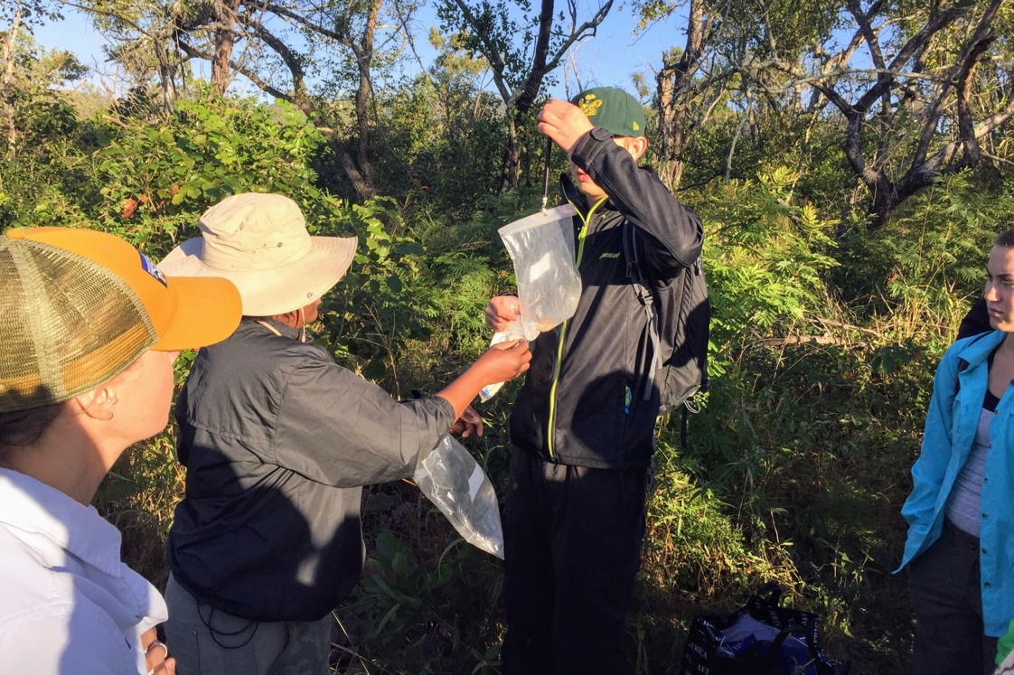
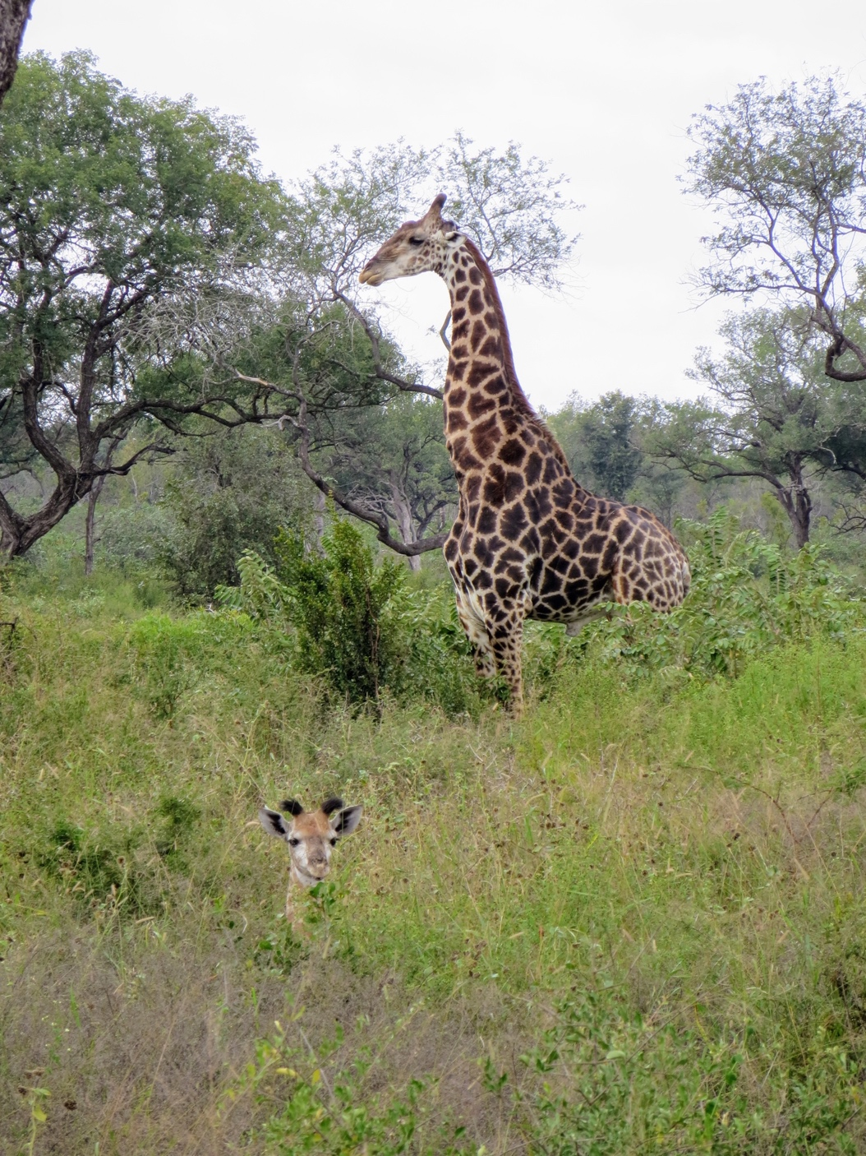
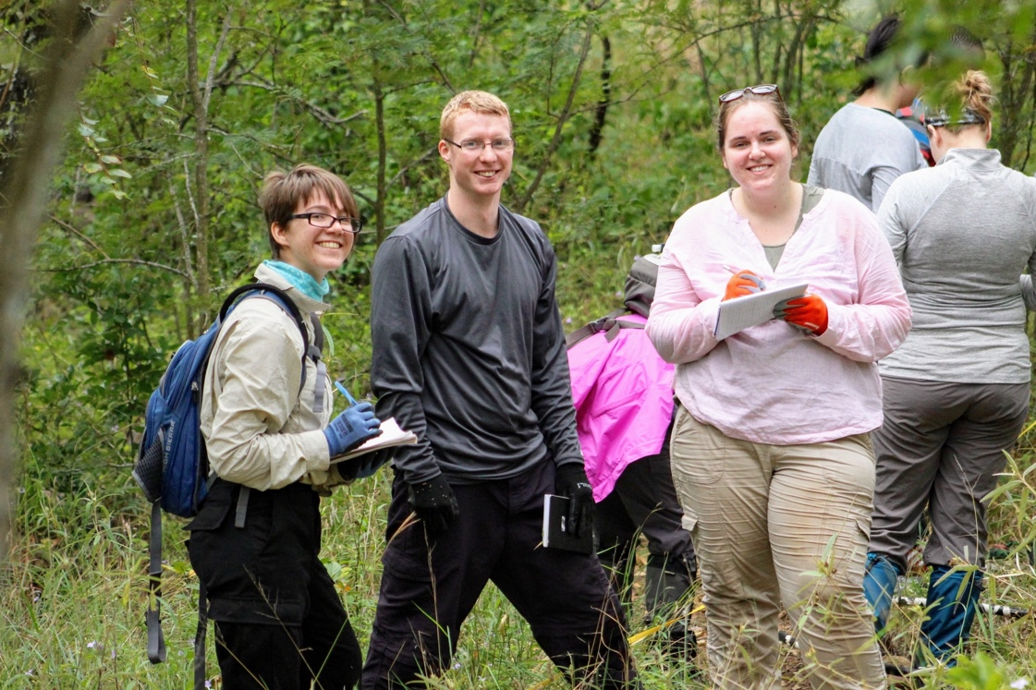

Slide 10
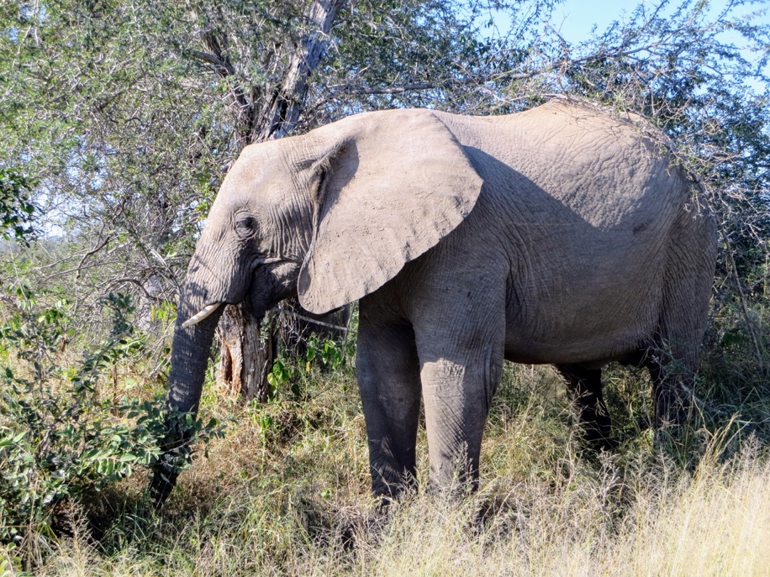
Safari in Kruger National Park
Capstone to Module One
Three day safari
Small course assignments associated with this trip

Slide 11
Module Two: Praia do Tofo, Mozambique
Road trip (~ 9-10 hours) from Kruger National Park to Praia do Tofo, Mozambique
Live and work in the small village of Praia do Tofo, on the coast of the Indian Ocean

Slide 12
Module Two: Coursework
Students must register for two courses
Some of these courses have field work/observation and CSL requirements, in addition to normal assignments and exams.
Typical Schedule
7:00 – 9:00 am: Class
9:00 am – 12:00 pm: SCUBA training, or coursework
12:00-1:00 pm: Lunch
1:00 pm – 5:00 pm: SCUBA training, field work
5:00 pm: Dinner
6:00 pm - ?: “Free” time
BIOL 361: Marine Science
BIOL 495: Field Methods in Marine Ecology
BIOL 498: Independent Research Project
Only for students who have completed BIOL 361
Additionally, students may complete SCUBA Open Water or SCUBA Advanced Open Water certifications
Note: SCUBA certification is not required for this course
Students are also required to complete a Community Service Learning (CSL) project, assigning with ongoing research with All Out Africa.

Slide 13
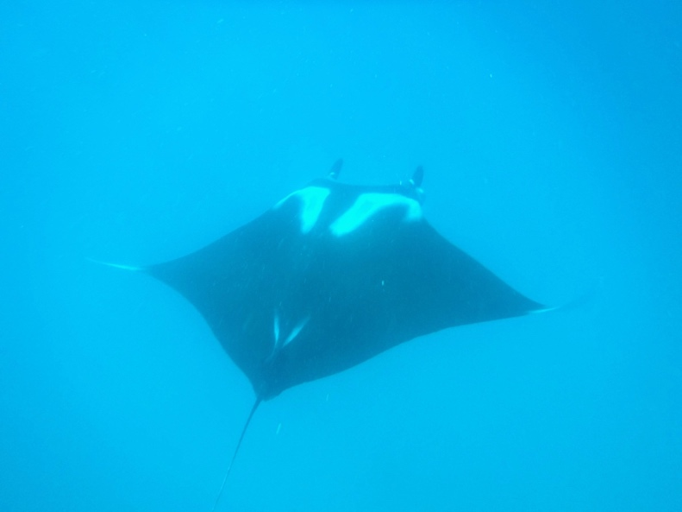
FAQ About Module Two
Do I need to be able to SCUBA?
No! There are many different projects to work on, though SCUBA does allow for a lot more opportunities
Can I prep for SCUBA training before departure?
Yes! Free (via the UofA SCUBA Club) in-class coursework is available, though not required for this module.
Will I have weekends off?
Maybe? Field activities for this module are more weather dependent than for other modules. You may have to be in class or in the field on weekends.

Slide 14
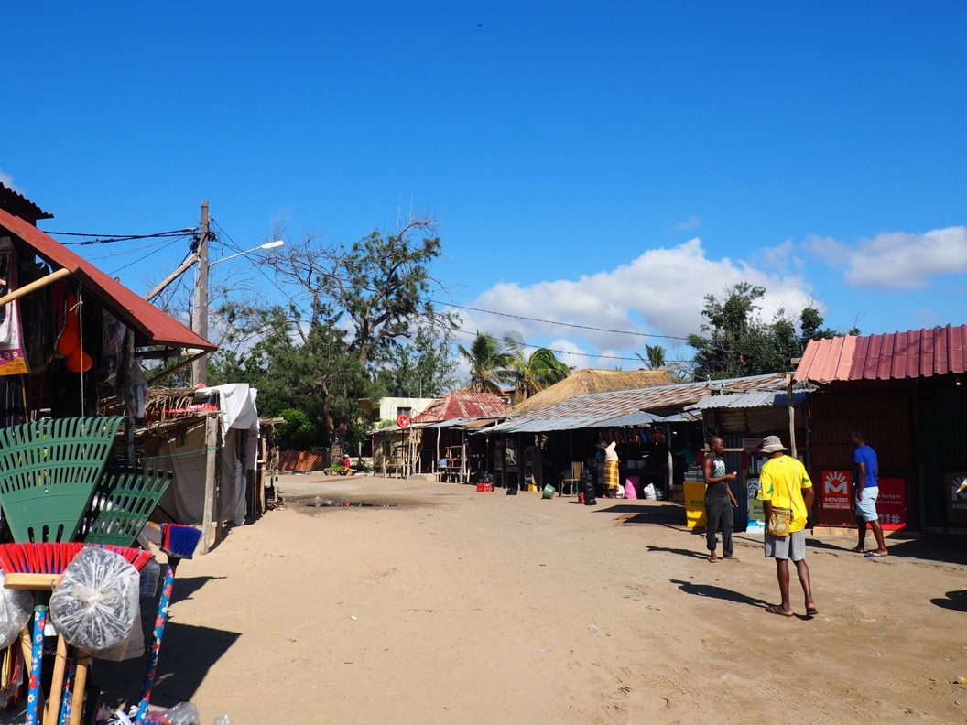
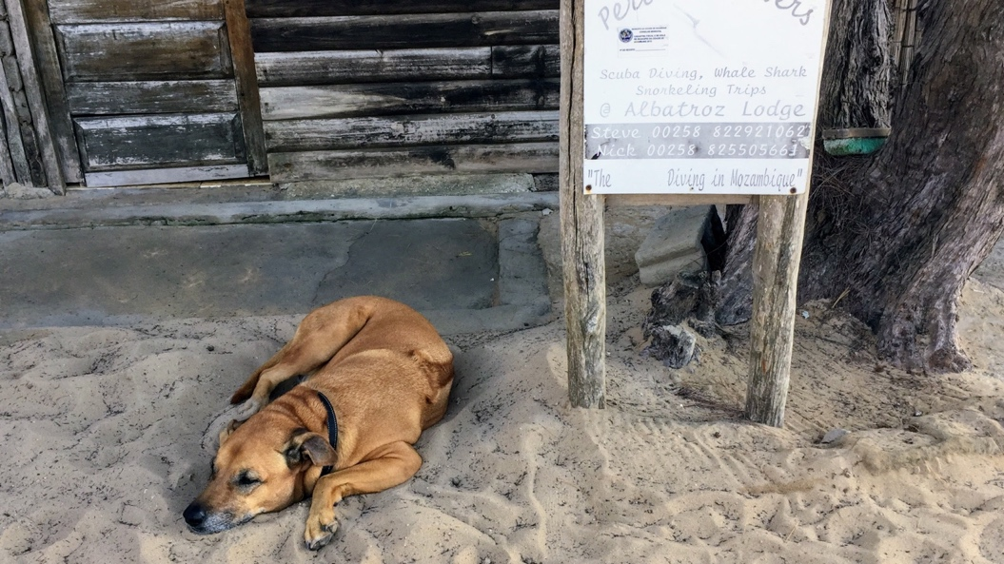
Accommodations

Slide 15
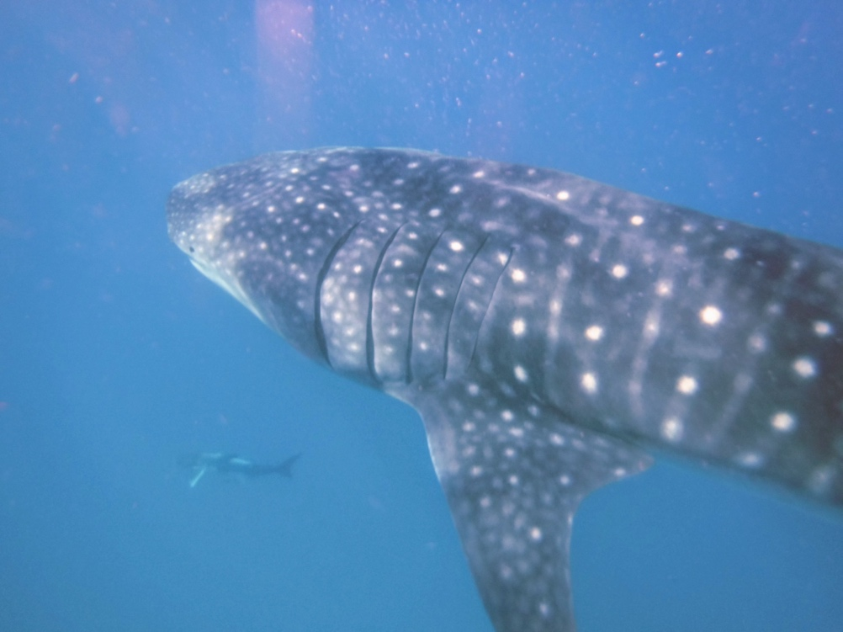
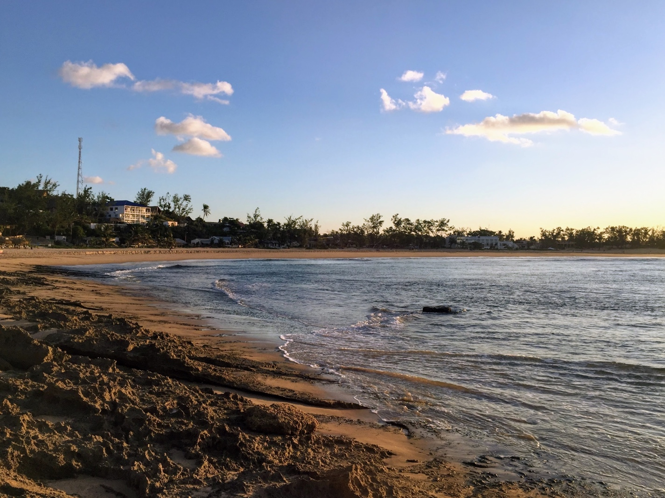
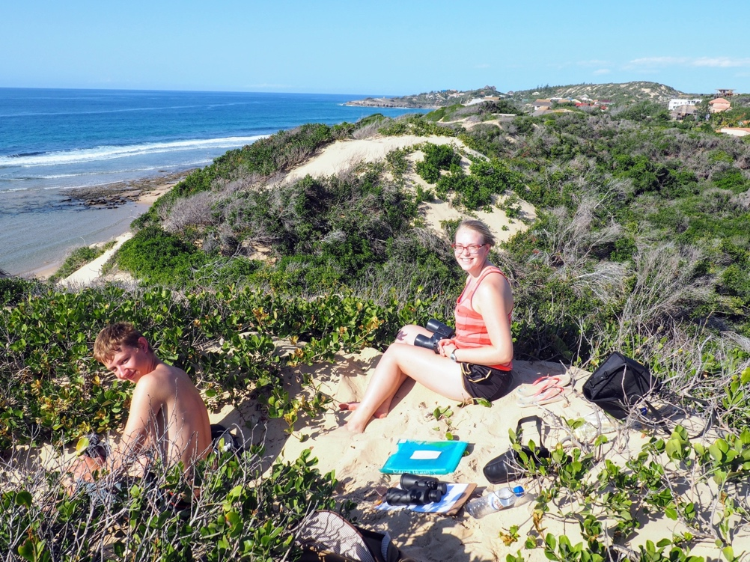

Slide 16
Road trip to Cape Town
After completing Module Two, students continuing to Module Three will take a six day road trip to Cape Town, making many stops along the way.
Why a road trip? Driving is more reliable than flying from Mozambique.

Slide 17
Potential Road Trip Stops
St. Lucia Estuary
Swazi Cultural Village
Durban, SA
Wild Coast [South Africa]
Port Elizabeth, SA
Tsitsikamma National Park
Garden Route [South Africa]

Slide 18
Module Three: Cape Town, South Africa
After completing your road trip SAFS is capped off with one month in Cape Town, South Africa.
You will live and study in the suburb of Hout Bay, and volunteer in various Township communities

Slide 19
Module Three: Coursework
BIOL 495: One Health: Zoonotic Disease
Students will also complete Community Service Learning (CSL) projects, assisting with ongoing community development and education with All Out Africa.
This course requires CSL work, in addition to normal assignments and exams
Typical Schedule
7:00 am – 12:00 pm: CSL placement
12:00-1:00 pm - Lunch
1:00-3:00 pm: Class
3:00-5:00 pm: Coursework time
5:00 pm: Dinner
6:00pm - ?: “Free” time

Slide 20
Accommodations

Slide 21
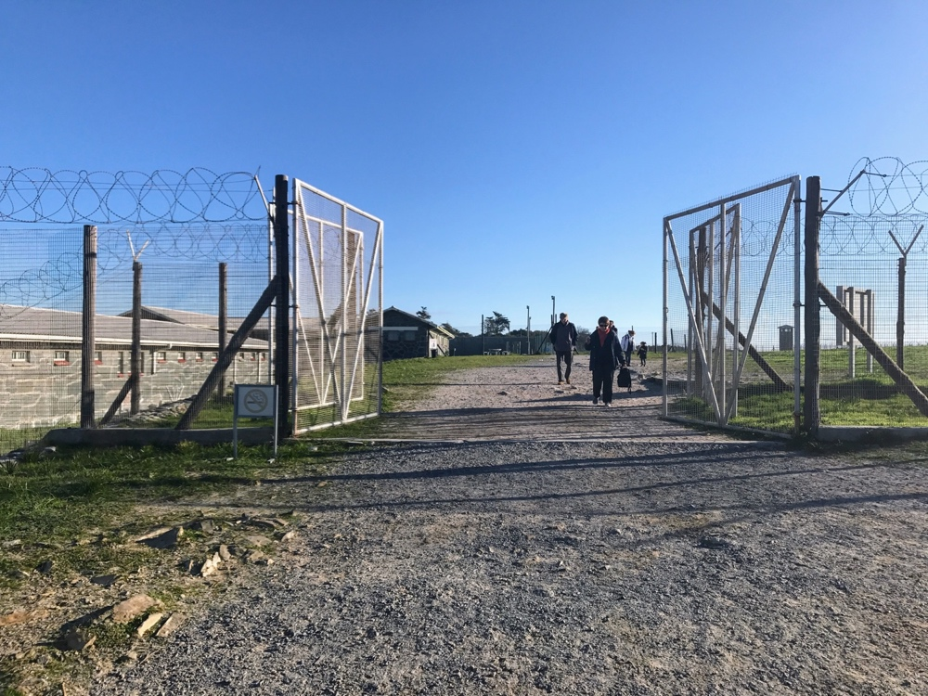
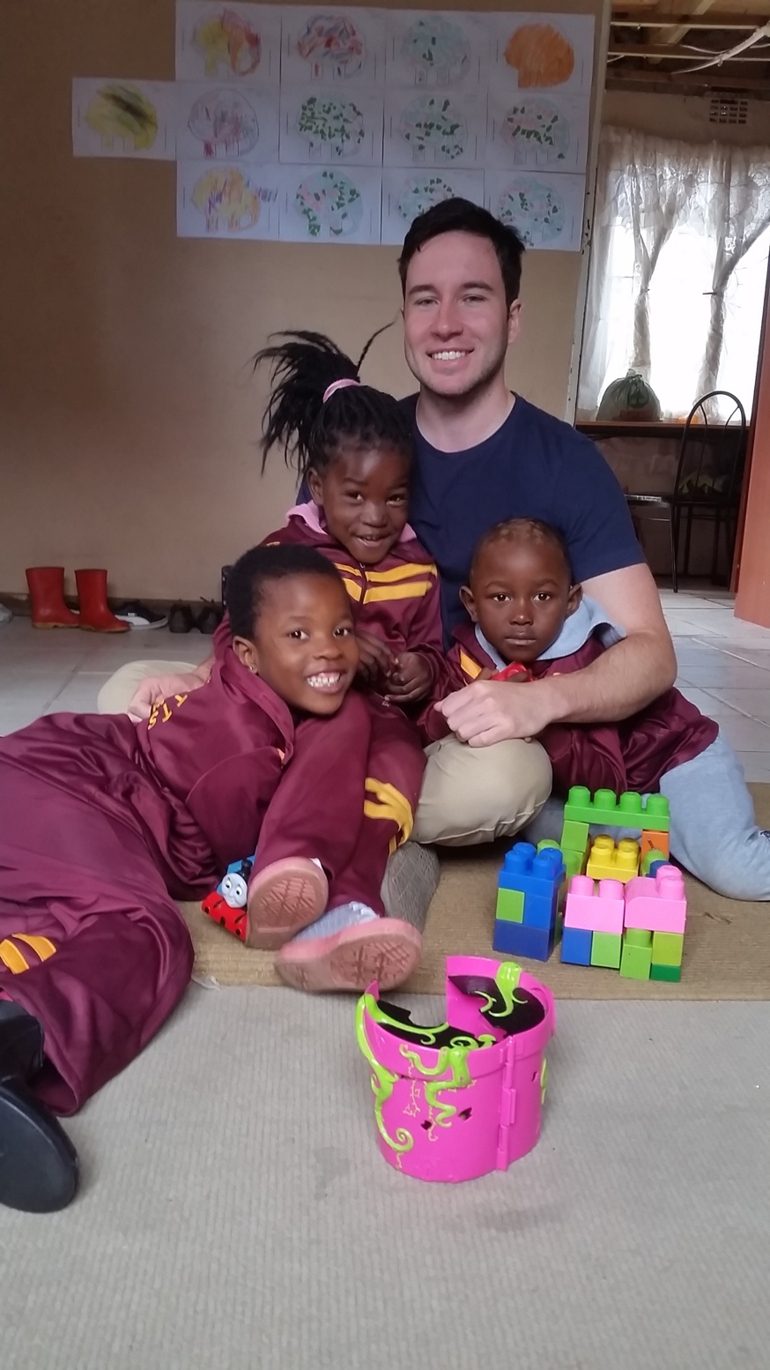
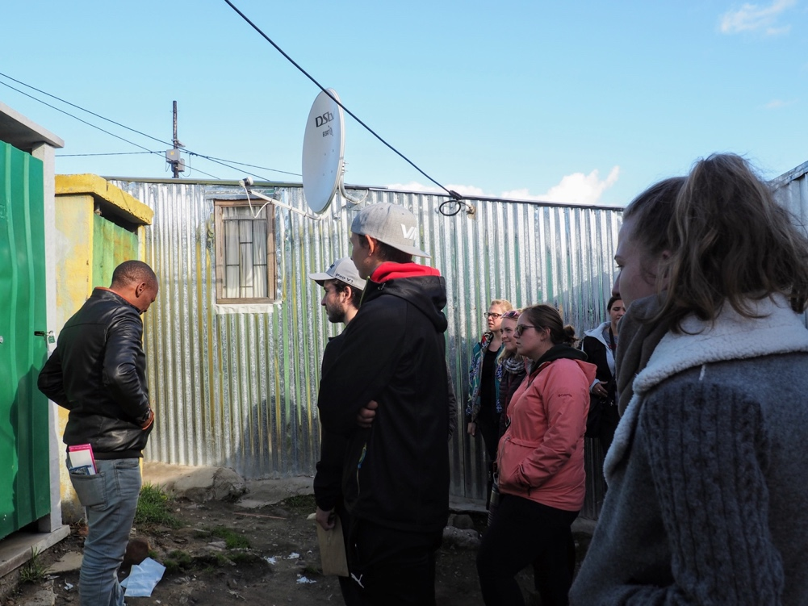
Notes:
Placements, Robbin Island

Slide 22
Frequently Asked Program Questions

Slide 23
Is it safe?
In short, yes!
SAFS and the University of Alberta take many precautions in preparing for and implementing this program. Before departure we complete a Field Activity Plan with Environmental Health and Safety at UofA.
Additionally, we work with All Out Africa to regularly assess situations while we are on the ground. All Out Africa staff are familiar with the risks associated with the areas we work, and help us maintain a safe program.

Slide 24
Is it safe?
Like anywhere, petty crime does occur.
Precautions We (and you should!) Take to Reduce Petty Crime
Limit mobile device use in public spaces, especially in urban areas
Carry minimal cash on your person
Keep valuables stored or locked up in accommodations
Don’t dress flashy
Stay aware of your surroundings
Notes:
Petty crime

Slide 25
Will I have internet and/or electricity?
Maybe?
Module One
Ezulwini – Reliable electricity, unreliable wifi
Field work – Generator/solar electricity, no wifi
Module Two
Praia do Tofo – Mostly reliable electricity, semi-reliable wifi
Module Three
Hout Bay – Reliable electricity and wifi

Slide 26
Will I have internet and/or electricity?
To cope with uncertainties with electricity and internet, we recommend that students:
Unlock their cell phones, and purchase local SIM cards for cellular data (it’s cheap!)
Bring an external power bank for mobile devices
Download and create an account for WhatsApp prior to departure

Slide 27
What vaccines and medication will I need?
Talk to Alberta Health Services
SAFS organizes a series of vaccines clinics with AHS to assist students in receiving their vaccines.
Students usually take anti-malarial medications for Modules One and Two
Additionally, we recommend that students talk to their doctors and/or AHS about bringing antibiotics with them, specifically for African Tick Bite Fever, and for “travelers tummy’.

Slide 28
Other Health Concerns
SAFS provides students with special insect repellant to treat their field clothing before departure, to treat their field clothing. This helps reduce cases of African Tick Bite Fever, an (easily treatable) bacterial infection similar to Rocky Mountain Spotted Fever.
Students should also religiously use insect repellant on their skin, either DEET or Icaridin-based, especially in Mozambique.
HIV is also prevalent throughout Southern Africa. Students are recommended to take appropriate precautions.

Slide 29
What kind of pre-launch training will there be?
A risk management session presented by UAlberta International.
An intercultural training session presented by UAlberta International.
An animal-ethics and small-mammal handling session, to prepare students for fieldwork in Module 1.
Students will receive a certificate for completing this handling
A series of three vaccine clinics with Alberta Health Services
Notes:
A risk management session presented by Travel Abroad. This session will give you the knowledge about University of Alberta procedures for risk management and for emergencies. You will be asked to finish a short online course on risk management to be completed before departure.
An intercultural training session presented by Travel Abroad. This session is structured to give you a general idea about what you may feel as you encounter a different culture during your travels. You will additionally receive information about Southern African culture, and about some of the cultural expectations and differences you may encounter.
An animal-ethics and small-mammal handling session, to prepare you for fieldwork at the Savannah Research Centre in Module 1. This session is optional, though highly required for all students who would like to help with small-mammal research during Module 1.
An opportunity for you to meet your fellow SAFS students, and to meet your future instructors.

Slide 30
What do I need to bring?
Don’t worry, we’ll give you a list once you’re accepted into the program
In general, you should bring:
Some camping gear, including a sleeping bag and quick-dry towels
Easy to wash (by hand) clothing, that can withstand field work
Swim/surf wear, for Module Two
Warm clothing for Module Three (think September/October in Edmonton)
Some easily portable electronics, including a laptop for assignments/exams, and a camera for all of the amazing wildlife you will see!
Regardless of what you bring, it should roughly fit in a large frame pack or roller duffel.
Notes:
Extensive packing list upon acceptance into the program.

Slide 31
Costs (in CAD)
 | Full Semester | Module One | Module Two | Module Three
Program Fee | $10,000 | $5,000 | $5,000 | $4,000
Ground Fee | $6,040 | $3,164 | $2,956 | $1,556
Total | $16,040 | $8,164 | $7,956 | $5,556
Additionally, students are responsible for booking their own flights (with assistance from SAFS). Flights to Southern Africa range from $1,700-2,000 CAD.
Notes:
Cost recovery, we don’t make money on this

Slide 32
That’s a lot of money!
Yes it is.
Remember though, that this includes (if you take all three modules):
Tuition for one semester (*15 credits!)
Room and board for three months
Ground transportation throughout Southern Africa
Admission to museums and tours in each study location
SCUBA Open Water or Advanced Open Water Certification
Up to ten SCUBA dives
A three-day safari in Kruger National Park
A seven-day road trip from Praia do Tofo to Cape Town

Slide 33
Potential Other Costs
Airport transportation
If departing after Module One: $70 CAD
If departing after Module Two: 600 meticals ($12 CAD)
If arriving for Module Two: 600 meticals ($12 CAD)
Mozambique Visa (for students participating in Module Two)
In Swaziland: $70 CAD (paid in ZAR cash)
Upon arrival: $70-90 CAD
Notes:
(If participating in Module One, will apply in person in Swaziland, if not participating in Module One, will need to apply upon arrival in Mozambique)

Slide 34
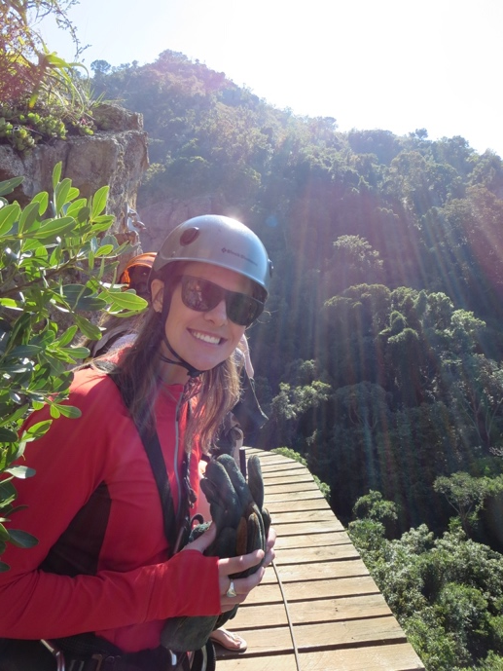
Potential Other Costs
Potential Additional Activities
(booked through All Out Africa, not endorsed by UofA)
*not all activities are listed, availability subject to change
Bushfire Music Festival ($350 CAD)
Round-trip transportation, tent accommodation, 3-day festival pass
Ziplining Tour and visit to Ngwena Mines in Swaziland: ~$100 CAD
Guided morning walk in Kruger National Park: 500 ZAR (~$45 CAD)
Guided sunset drive in Kruger National Park: 280 ZAR (~$25 CAD)
Guided night drive in Kruger National Park: 230 ZAR (~$20 CAD)

Slide 35
Embedded Certificates
Earned in conjunction with your major/minor.
Participation in SAFS fulfils several of the requirements for two UofA embedded certificate programs.
Certificate for International Learning (CIL)
http://www.globaled.ualberta.ca/CertificateinInternationalLearning.aspx
Certificate in Engagement and Service-Learning (CSL)
https://www.ualberta.ca/community-service-learning/csl-student-info/certificate-program
Notes:
CTL and CIL, CSL

Slide 36
Application Requirements
All faculties and disciplines are welcome!
Have a minimum GPA of 2.3 or higher in the last Fall/Winter semesters
Have successfully completed at least *15, or more as required by their home Faculty/Institution, by the start of the SAFS program
Have successfully completed BIOL 108*
Have a valid passport and or visas to study in South Africa, Mozambique and Swaziland
*students without BIOL 108 but who are enrolled in the BScN program may be enroll in Module Three, pending approval from the Faculty of Science
Notes:
How Applications Are Reviewed
Degree requirements, talk to program advisors in home faculty

Slide 37
Instructions How to Apply (UofA Students)
Fill out the fillable application: https://www.ualberta.ca/african-field-studies/how-to-apply
Upload a single PDF file with a cover letter and CV/resume
Upload a PDF copy of your transcript from Bear Tracks

Slide 38
Instructions How to Apply (non-UofA Students)
Fill out the fillable application, and save it: https://www.ualberta.ca/african-field-studies/how-to-apply
Apply to the University of Alberta as a visiting student (you will have to meet admission requirements and deadlines)
Email safs@ualberta.ca with
Application
PDF file with a cover letter and CV/resume
PDF file of your transcript

Slide 39
Additional Requirements for Non-UofA Students
Enrolment in a degree program at your home institution
A letter of permission from your home institution
Have completed 24 credits (*24) at your home institution
Satisfactory academic standing at your home institution
Students applying to the University of Alberta, Faculty of Science, as a Visiting Student must apply by February 1st, 2018, and pay a $125 application fee to the Faculty of Science.
To apply as a visiting student, visit: https://gandalf.registrar.ualberta.ca/Admission/Application/start-page

Slide 40
Application Cover Letter and CV/Resume
Cover Letter
CV/Resume
Why do you want to participate in Southern African Field School?
Which module(s) you would like to complete?
What are your career goals and how do you think this program/module will benefit you?
What do you think will be the greatest challenge/benefit of participating in Southern African Field School?
What life/work/study experience you have that will benefit you in preparing to study abroad.
Name/Contact information
Education
Employment experience
Volunteer and extracurricular interests
Previous research experience (if any)

Slide 41
Application Deadlines
Priority Deadline: December 1, 2017
Late Deadline (if spots are available): January 25, 2018
Applications are reviewed every two weeks. Students who apply by or on the priority deadline will have a decision by Friday, December 15th.

Slide 42
After Acceptance

Slide 43
Fee Payments
Fee payments are broken down into three components for SAFS. The first payment is due upon acceptance, and is half (50%) of the ground fee total. The other half is due on March 15, 2018 as a second payment.
Both the first and second payments are due as cheques written out to the Department of Biological Sciences and should be given to Evan Wong at Bio Sci CW 405.
The third payment is due on March 15, 2018, and is paid to the Office of the Registrar (Registrar’s Office) through Bear Tracks.
UofA collects Program Fees, while SAFS directly collects Ground Fees

Slide 44
Required Forms (All are due March 15, 2018)
Medical Forms
(Doctor assisted form)
PADI Forms
(Doctor assisted form)
Peri Peri Diver Form
Visa Waiver Form
Disclosure of Personal Information Consent Form
Risk Management Agreement and Indemnity Form
Emergency Contact Form
Student Detail Form
CAGFIL Application Form
Financial aid
Add/Delete Forms
Notes:
Forms

Slide 45
Stay Tuned for Information About Pre-Launch Training
Sessions usually start in mid-January, to ensure enough time to receive all necessary vaccines.

